Slide 1
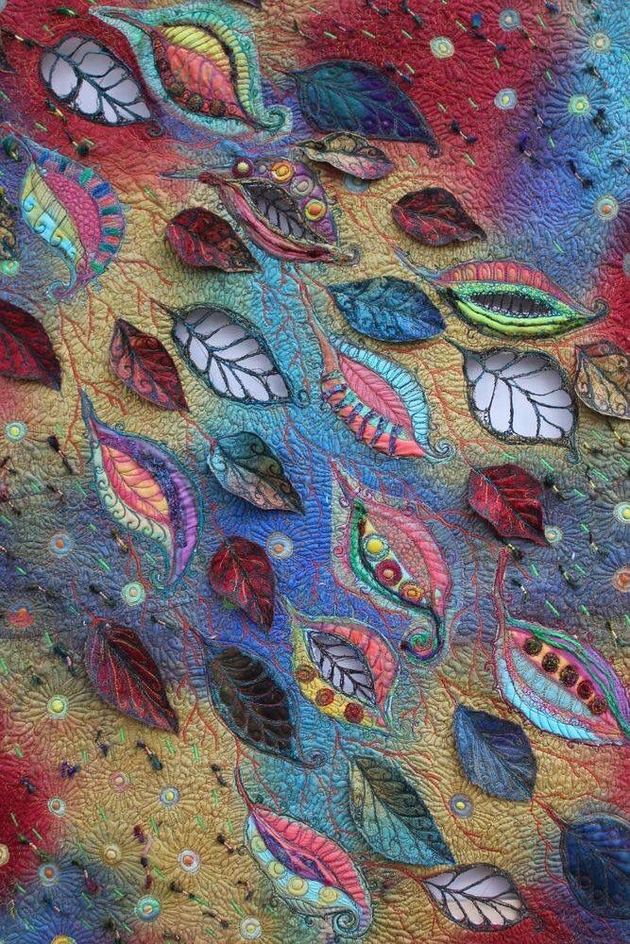

Revision Guide
Year 11
GCSE Textile Design

Slide 2
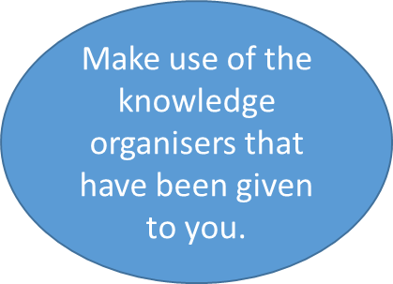

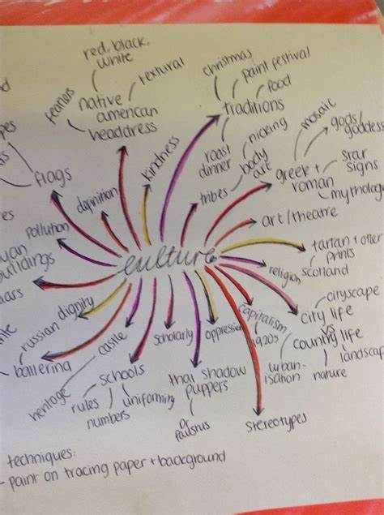
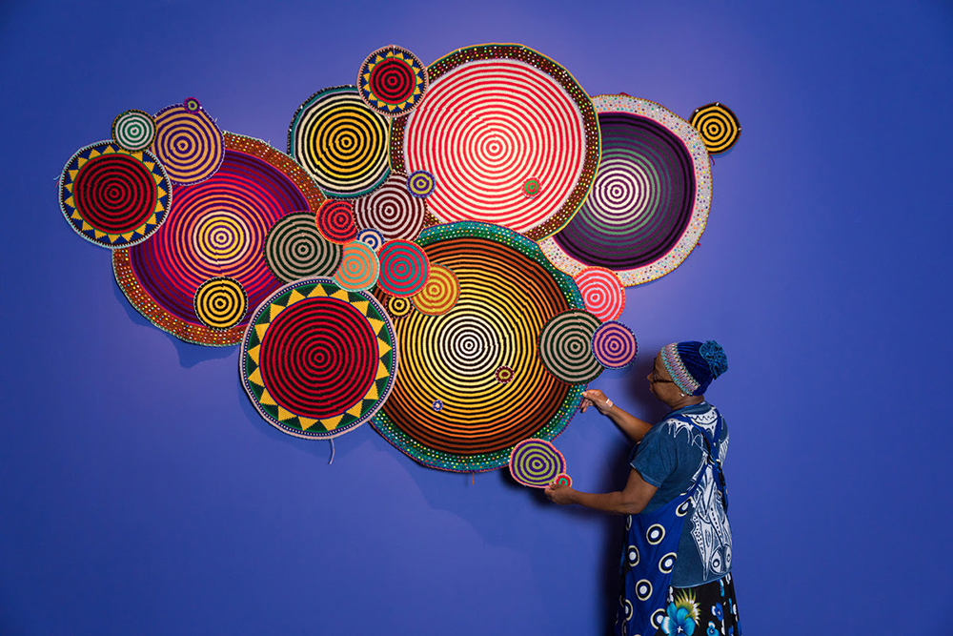

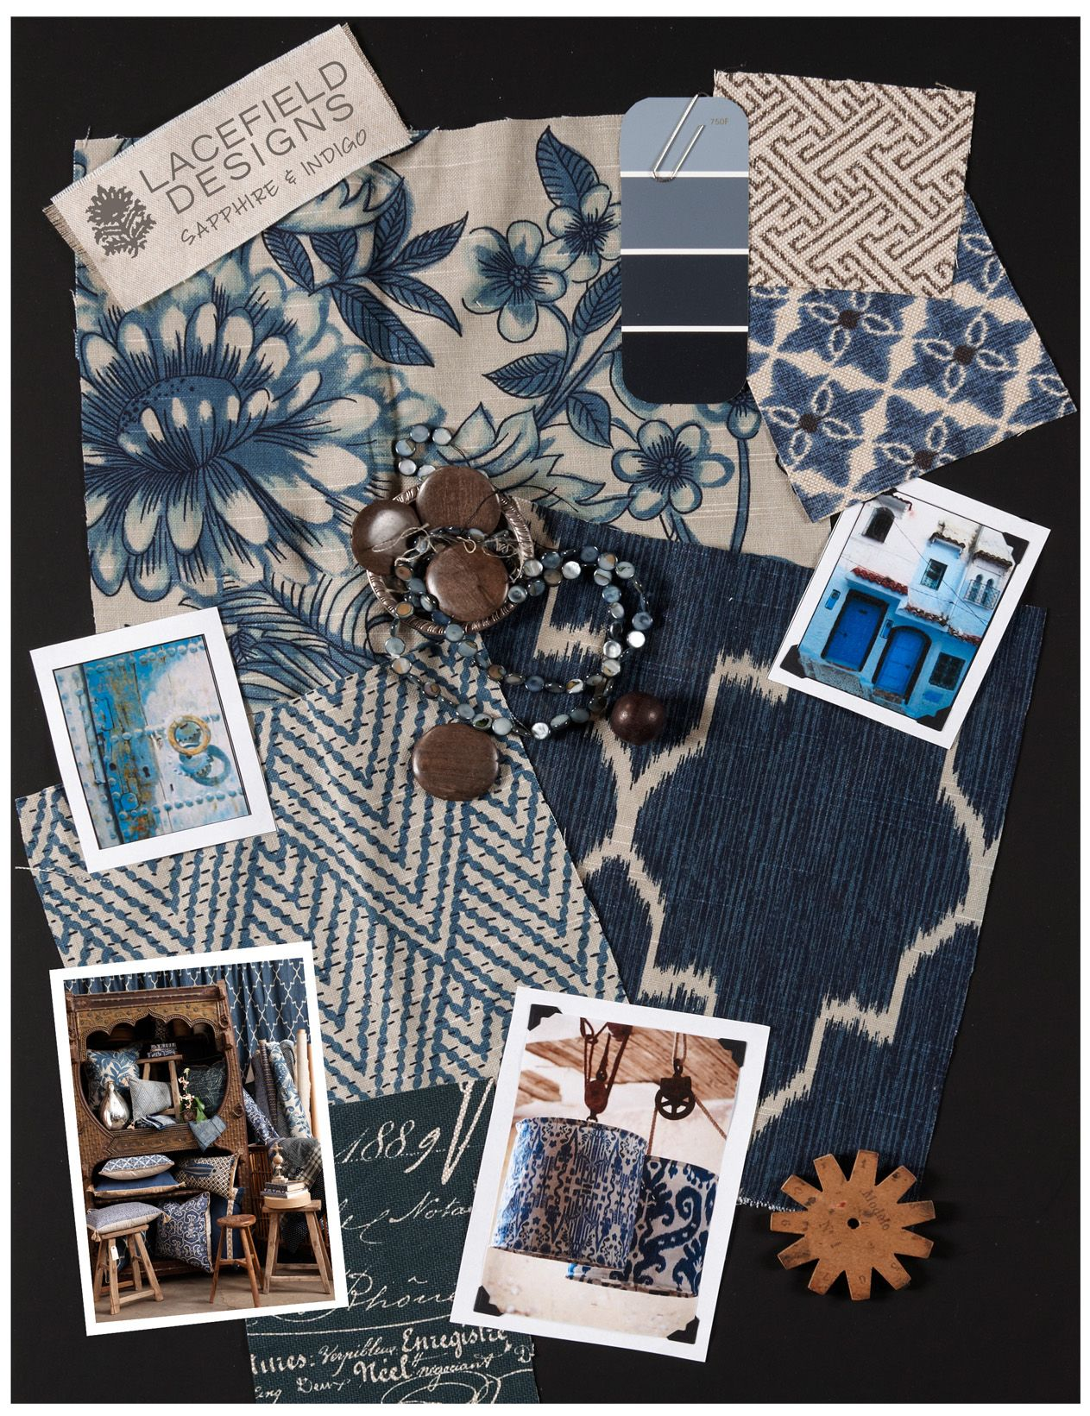

What is a source?
Next Steps…. Using a source
Keywords to use in your analysis
A source can be absolutely ANYTHING you are inspired by! Below is an example of different sources you might include in your sketchbook:
A Theme Mind Map – Mind map all the things you can think of relating to your topic! Include images if you want to.
Mood Board – Collect images linked to your theme into a moodboard – annotate keywords about the images / theme.
Artist / Designer Analysis – Look at an existing artist or designer and complete an analysis of their work
Take your own photographs – You can use your own photos as a source of inspiration! Annotate them explaining how they link to your theme.
Once you have analysed a source – what do you do next?
Here are some ideas:
Complete a textile sample, using your source as inspiration
Do some initial idea sketches, using your source as inspiration
Compare 2 different sources in your sketchbook using a VEN diagram
Aesthetics
Style
Process
Trend
Connotation
Textile Technique
Movement
Colour
Line
Form
Tone
Texture
Shape
Pattern
Decoration
Repetition
Scale
Structure
GCSE Textiles – A01
Develop ideas through investigations, demonstrating critical understanding of sources
Useful websites to find Textile Artists and Fashion Designers
  https://www.textileartist.org/
  https://www.patterndesigners.com/top-10-textile-designers-2017/
  https://www.dexigner.com/directory/cat/Textile-Design/Designers
  https://www.msn.com/en-us/money/other/30-most-influential-fashion-designers-of-all-time/ar-BBNNj6y
  https://sewguide.com/famous-fashion-designers/
  https://pahaldesign.com/10-best-fashion-designer-of-world/
  https://www.textileartist.org/10-contemporary-embroidery-artists
How to Analyse a Designer / Artist:
Introduce the work of your designer or artist (key facts only), how does their work fit into trends at the time it was produced or current trends?
Are there any social, environmental, moral, issues surrounding your designers work?
Consider what key features appear regularly in your designers work, why might that be?
What colours do they use a lot of? What effect does this give?
Who do you think their designs are aimed at? Why?
Explain what you like / dislike about the designs and why that is.
What techniques has the designer used? Why? Could different techniques be used to create different effects?
How will this designer inspire your work? How does the designer fit into the theme? What techniques will you sample? Why?
Key Points to Remember
There is a difference between Analysing and Stating. Analysing will always get you more marks that stating.
Denotation: Literally stating what something is
Connotation: Explaining the meaning of something, what it connotes.
See the below example:
This is a pink heart.
It connotes, love and friendship

Slide 3
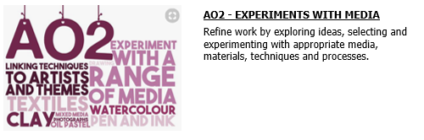
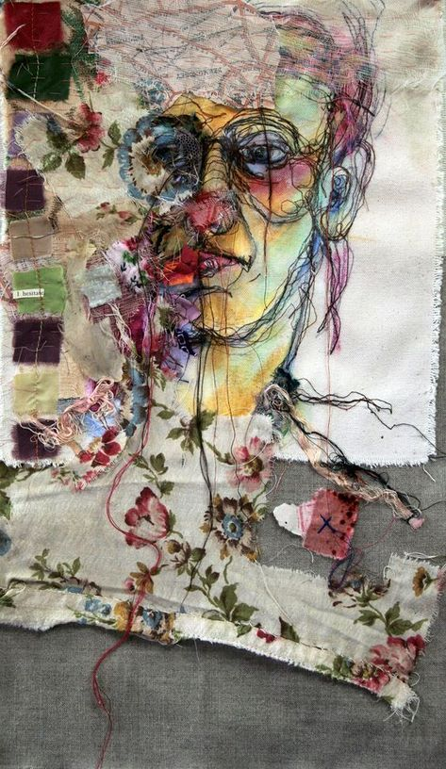
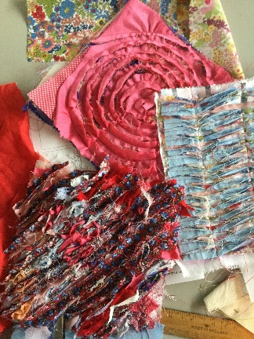
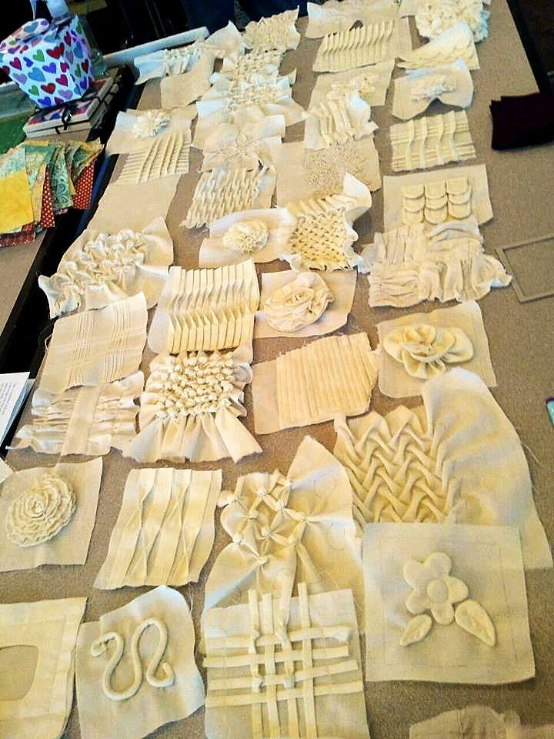
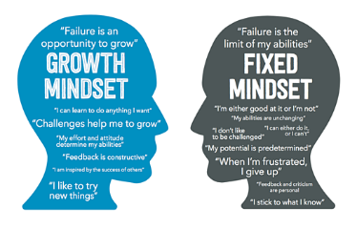
What do I do to meet the assessment objective?
Next Steps…. Using a sample
Key Textile Techniques to try
Patchwork
Pleating
Printing
Quilting
Ruffles
Smocking
Suffolk Puffs
Tie Dye
Weaving
3D Shibori
Once you have completed a sample– what do you do next?
Here are some ideas:
Cut the sample in half – keep one half as the original and develop the other half with a different technique
Sketch an initial idea to show how you would use this sample in your work
Evaluate your sample to help you refine your ideas and techniques
Applique
Batik
Beading
CAD
Couching
Embroidery
Felting
Knitting
Macramé
Mola
Use the words in the assessment objective to help you understand what it is you should do:
Refine work: Quality over Quantity! – Refine work by going back to old samples and developing them to make them better. Refine work by comparing samples and evaluating to see what works and what doesn’t.
Explore Ideas: This can be as a sketch or textile sample, try to create the idea in your head – it doesn’t matter if it doesn’t work – it’s a sample!
Experimenting with appropriate media, materials and techniques – practice creating samples using a range of different techniques, make sure you know how to them using the correct materials. Don’t be afraid to experiment and combine different techniques to see what effect they give! – Think outside of the box.
GCSE Textiles – A02
Refine work by exploring ideas, selecting and experimenting with appropriate media, materials, techniques and processes.
Useful tutorial websites to help with samples
  http://www.embroidery.rocksea.org/reference/picture-dictionary/
  https://www.ritdye.com/techniques/
  https://www.theweavingloom.com/beginners-guide-to-weaving/
  https://rosiepink.typepad.co.uk/rosiepink/tutorial-how-to-make-flat-felt-wet-felting.html
  https://www.polkadotchair.com/45-beginner-quilt-patterns-tutorials/
  https://mypatchwork.wordpress.com/2014/07/26/41-fabric-manipulation-tutorials/
How to Evaluate a sample:
Key Points to Remember
Growth Mindset!
If a sample goes wrong, THAT IS FINE! – this is why we sample, just remember to evaluate it and next time we can do things differently
What have you done?
What techniques did you use?
What inspired you?
How does it relate to your theme?
How have you done it?
What did you like / dislike about the technique?
Was it successful? Why / why not?
How could you improve?
What else could you try?
Is there anything you would change? Why?
How will you develop your work now?

Slide 4
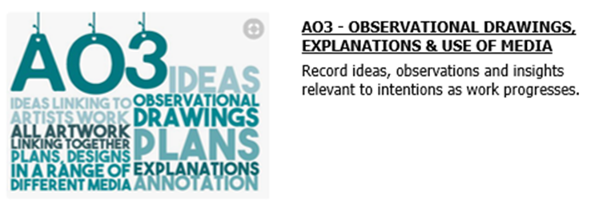
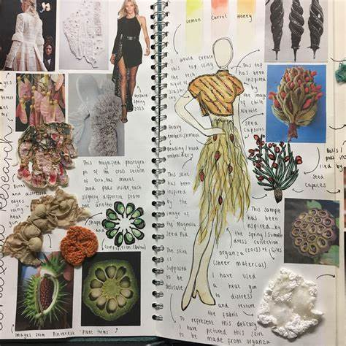
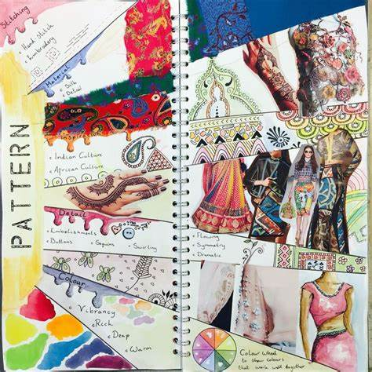
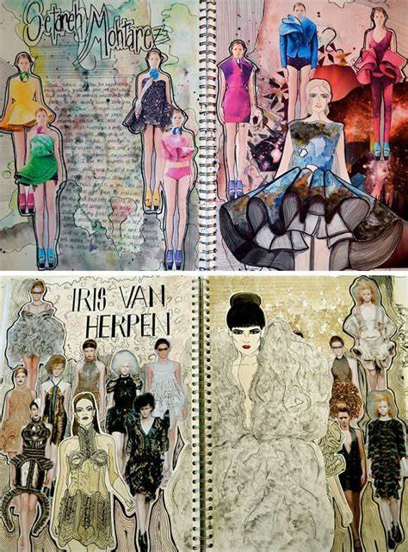
How can I record my ideas?
Next Steps…. Developing Ideas
Media you can use to record ideas
(or anything else you can think of!)
Recording ideas is really important to show your teacher and the examiner your thought process and development. Here are some ways you can record ideas:
Design Ideas – Draw out your design ideas, they should be clearly inspired by your samples or sources. Annotate these to explain parts of your designs
Observational drawing – Sketching objects that relate to your theme can help inspire design ideas – especially when creating patterns
Take photographs – take photos of sources for inspiration or take process photos when you are making samples as evidence.
Annotation – Annotation, ensure you annotate to explain your thoughts, this does not need to be a lot of writing, sometimes you might just bullet point!
Once you have recorded your ideas, what do you do next?
Design ideas – develop design ideas by varying aspects e.g. size, shape, features etc.
Observational sketches – use the sketches to develop a repeat pattern
Take photographs – annotate your photos when they are stuck into your book
Annotation – underline any key points you have made / keywords to make it easy for the examiner to identify
Design ideas / drawing
Pencils
Collage
Watercolours
Paints
Chalk Pastels
Charcoal
Fineliners
Pen
Artist Markers
Photoshop (CAD)
Photographs
Insights / written annotation
Written – pen / pencil
Bullet points / key words / paragraphs
Typed up on the computer
GCSE Textiles – A03
Record ideas, observations and insights relevant to intentions as work progresses.
How to annotate a design:
Key Points to Remember
Useful tutorial websites to help you with drawing
What textile techniques have you used in your designs? Why?
How does it link to the samples you have done?
Is you design inspired by any of your sources? How? Why?
What materials would you use? Why?
How does this design link to your theme?
What developments would you make to your designs? Why?
Any design ideas you do should CLEARLY link back to AO1 and AO2.
All designs should show how your sources have inspired them – include this in your annotation
All designs should include AT LEAST three different textiles techniques that you have sampled.
  https://www.youtube.com/watch?v=nXKFBA0xeYQ#
  https://www.youtube.com/watch?v=r1idghDW8KY
  https://www.youtube.com/watch?v=U68FvwHaOoE
  https://www.idrawfashion.com/friday-tips/
  https://www.mybluprint.com/article/drawing-folded-or-draped-fabric-is-an-art-heres-how-to-crush-it-in-a-few-easy-steps
  https://www.idrawfashion.com/clothes/textiles/

Slide 5
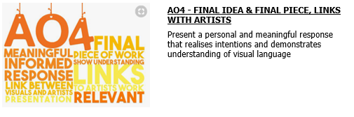
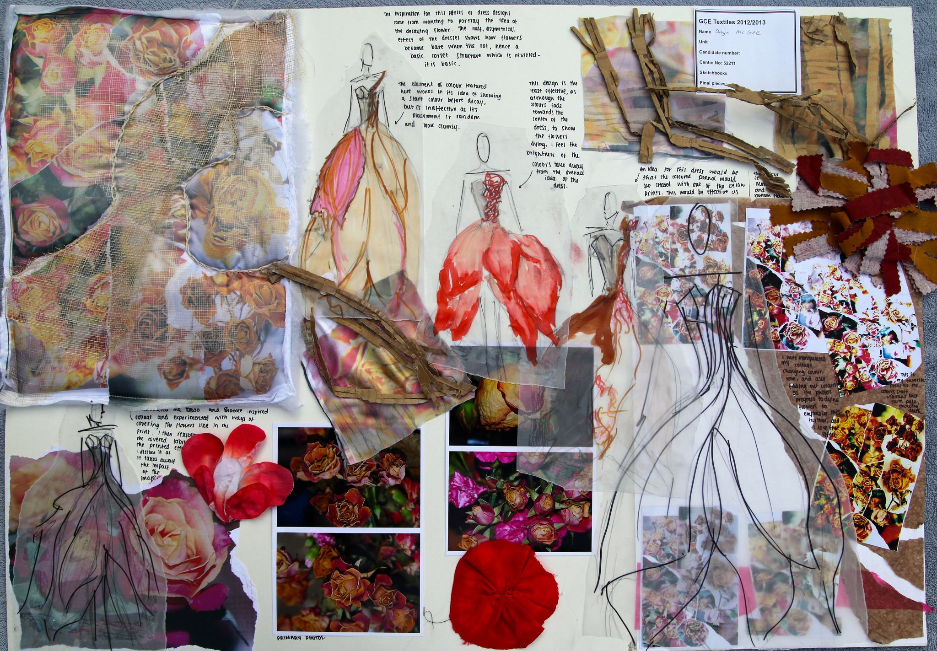
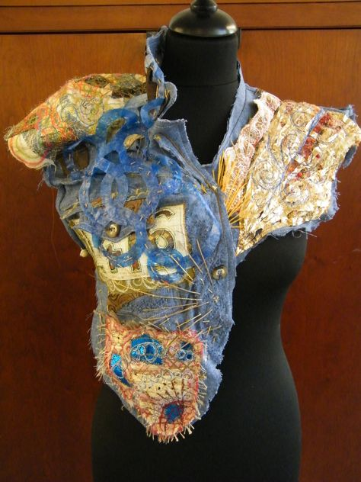
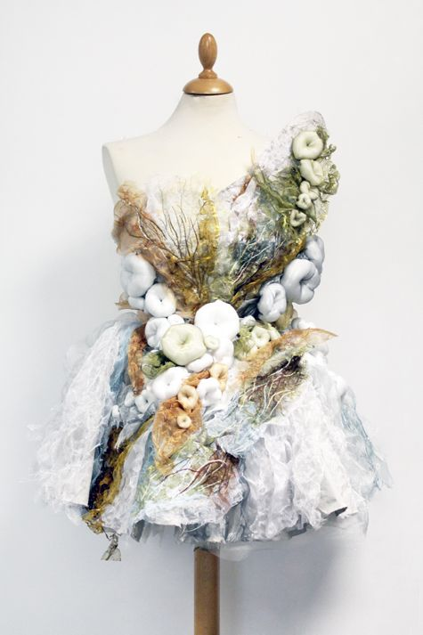
How can I meet this Assessment objective?
Next Steps…. Creating a final piece
Ways of showing a personal response
Use the words in the assessment objective to help you understand what it is you should do:
Personal and meaningful response –Your response to a source should be personal to you. What your feelings and reactions are. It must be meaningful by relating to your source inspiration. Make sure everything links and is not random.
Demonstrates understanding of visual language – being able to combine different textures, colours, techniques in an aesthetically pleasing way.
Aesthetics – the way things looks
Though you can demonstrate AO4 throughout your sketchbook, a final piece will help you secure marks.
Make sure you have developed you design ideas
Select the design you would like most to make
Sketch out your final design, planning what techniques you will use where
Plan your making step by step to make it
Creating your own designs
Developing your designs
Creating a sample inspired by a source
Creating a developed sample inspired by a combination of sources
Producing a final piece (fashion or interiors)
Developed Sample:
GCSE Textiles – A04
Sample inspired by a source
+
Sample inspired by a different source
=
Developed sample using combined techniques
Present a personal and meaningful response that realises intentions and demonstrates understanding of visual language.
Reflection on entire project:
You DO NOT need a whole project reflection, however if you have the opportunity and are stuck on what to do next, it is a nice touch.
What was your initial theme and how were you inspired by it?
How did you begin your research? Why?
How do your samples reflect your own ideas (i.e. your personal response)
What would you do differently? Why?
If you were to develop this theme / project, how would you do it? Why?
Key Points to Remember
Websites where Designers talk about their work and inspiration
A personal response is any response where it is your own work.
It is not just your final piece, it is all individual work throughout your folder
You can be inspired by designers but don’t copy them, because this is not personal i.e. your own work.
Record the step by step process of creating any developed sample final piece – you can do this with photographs or sketches
Sometimes it is difficult to come up with a personal response! The below links show some designers talking about their design and inspiration process. Seeing how they come up with their ideas, might help you come up with your own.
  https://fashionunited.uk/news/fashion/10-fashion-talks-to-watch/2018102239556
  https://www.designboom.com/design/interview-with-fashion-designer-carla-fernandez-05-14-2014/
  https://www.instyle.com/awards-events/fashion-week/new-york/fall-2017-designer-inspiration

Slide 6
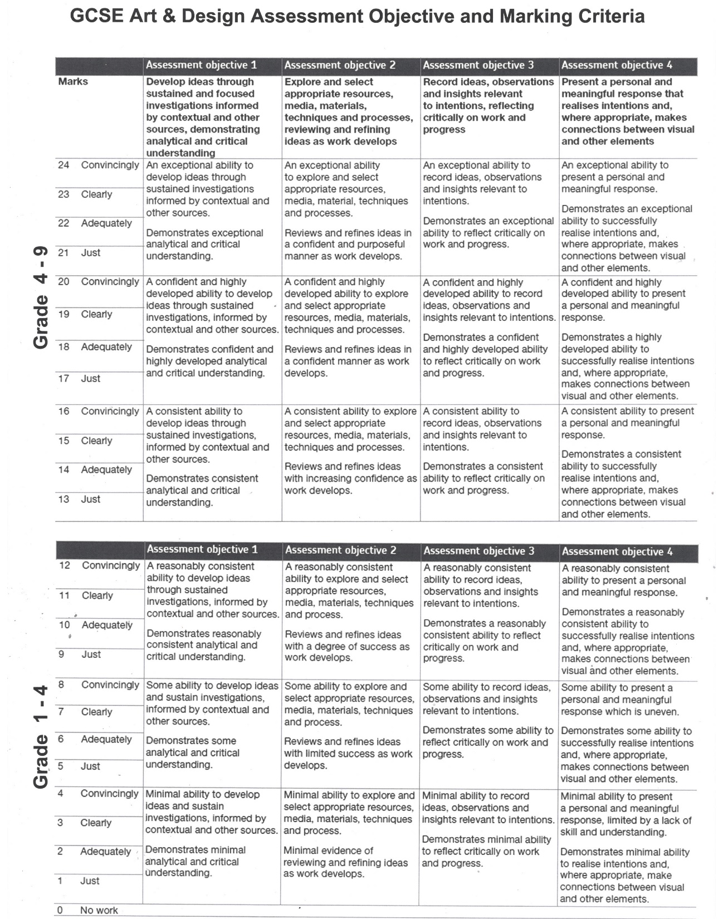
It is useful to familiarise yourself with the assessment objectives marking criteria.
Look at the wording and assess yourself on where you would mark yourself under each objective.
This is what is used when moderating your work at the end of the course

Slide 7
Useful Websites/Pages to Visit
TextileArtist.org - Be inspired to create This site has numerous textile artist that might use techniques that could link to your theme. When you like an artist work, go into their own site to view galleries of other samples they have produced.
Pinterest: There is no better way to understand what excellent work looks like than by looking up posted sketchbooks. Talented students routinely post to Pinterest and other social networking sites. Past sketchbooks can also provide inspiration for how to present your work and inspirational artists.
YouTube: This platform hosts many videos particularly interesting to GSCE textile design students. You may search the site to find students showing their work, page by page. They narrate their work in loving detail while pointing out their less noticeable features.
Some of the best advice provided include the importance of focusing on quality rather than quantity. These students aver that you should not be afraid to experiment and even make mistakes. That way, the examiners can see your process; the steps you've taken to create your works of art. They'll impress upon you that an excellent sketchbook doesn’t have to be tidy.
The Biggest Trends Of Couture SS22 Fashion Week | British Vogue This excellent resource makes it possible for fashion lovers and students alike to discover the worlds fashion scene. Search for information on the lives and work of thousands of designers, discover where you can view important collections. Remember you are not looking at high street fashion but Haute Couture!

