Slide 1
Revision Guide
Year 11
GCSE Art & Design

Slide 2

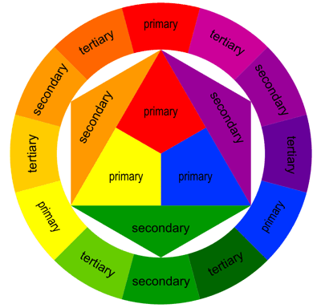
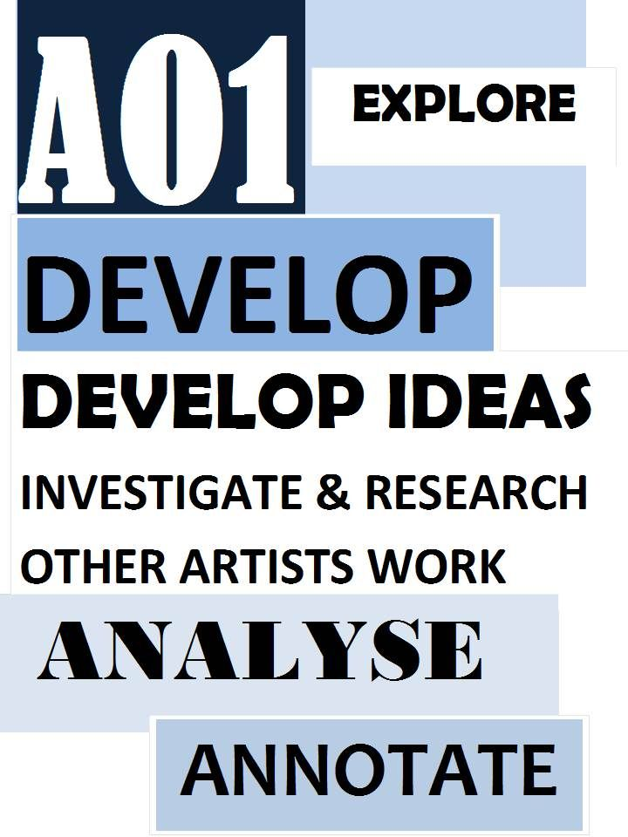
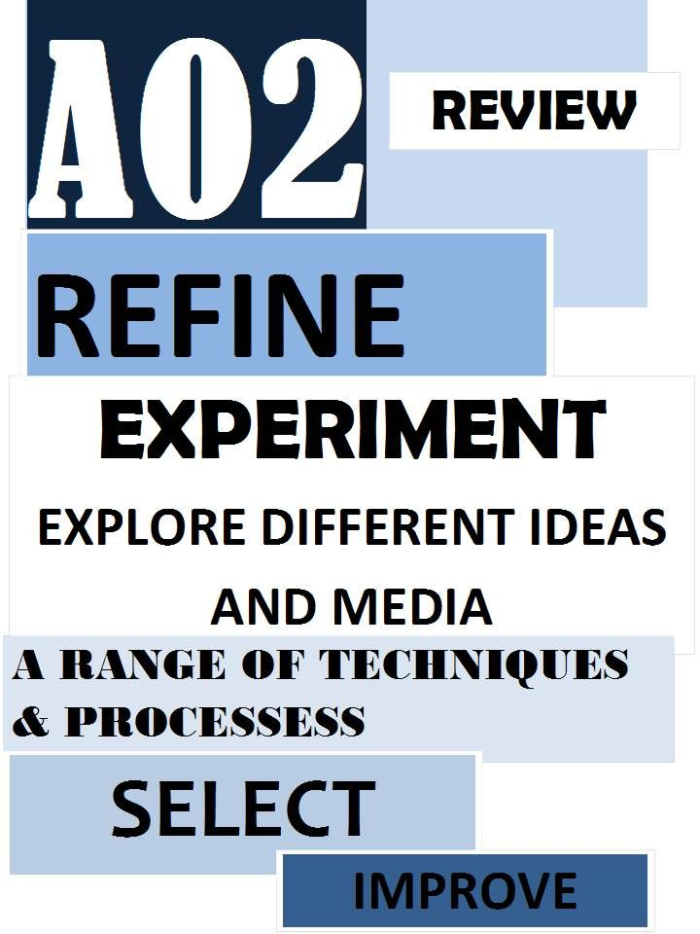
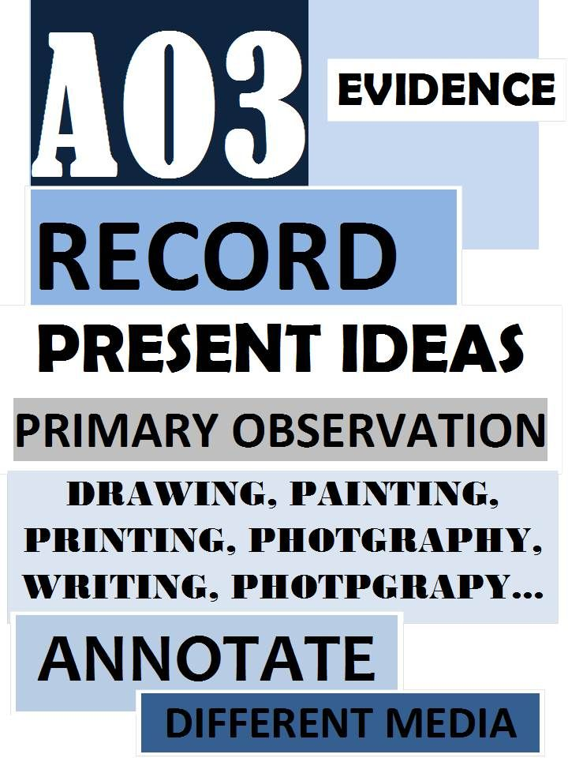
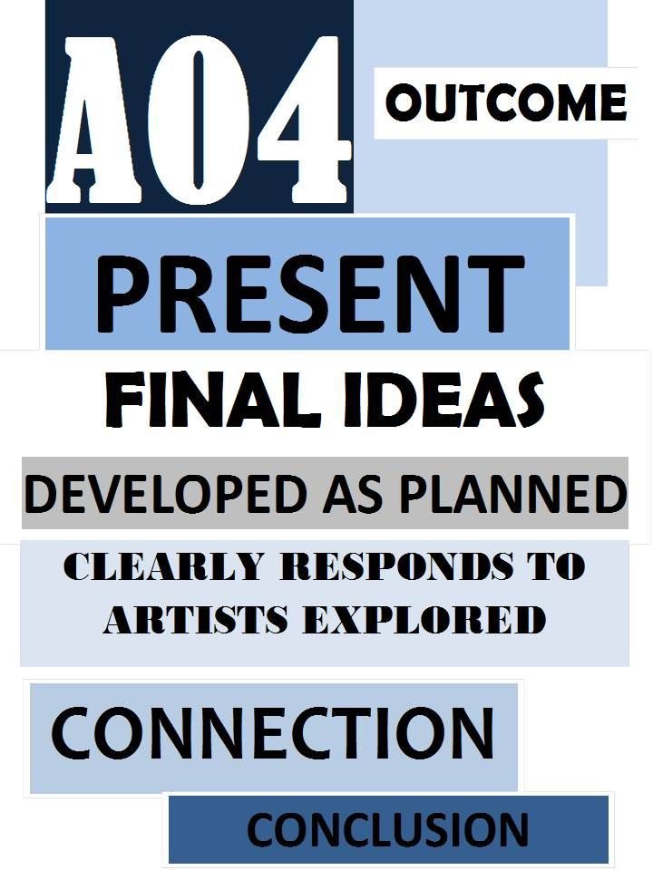
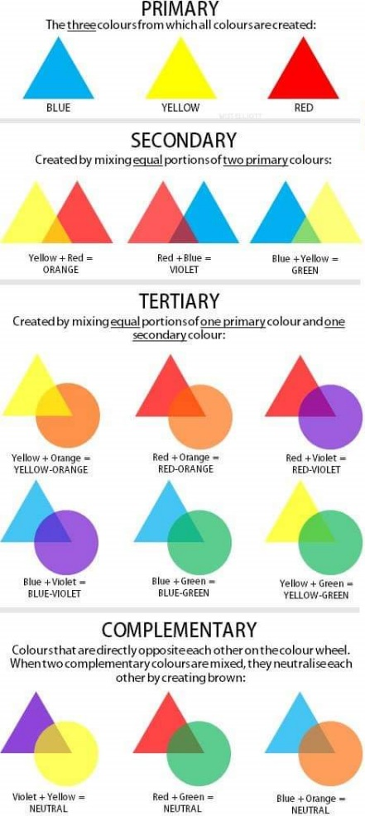
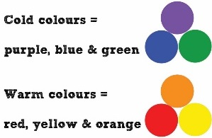
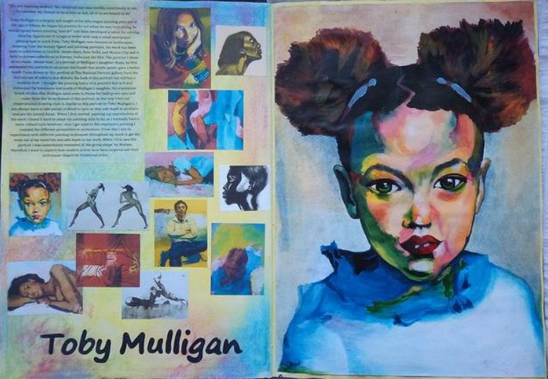
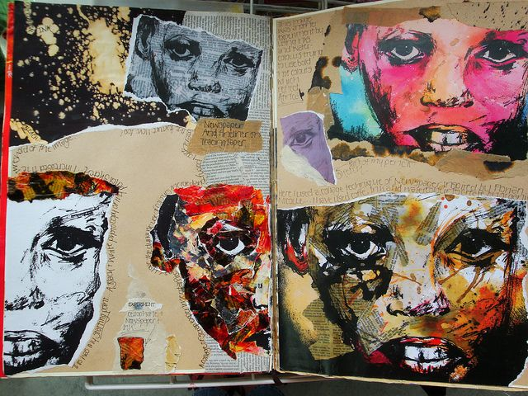
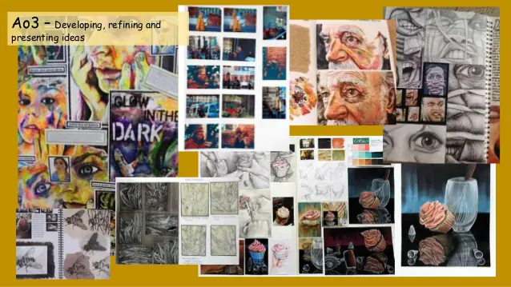
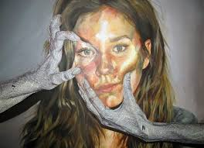




GCSE Art
Theses are the skills and facts you need to know throughout your GCSE Art & Design.
Make use of the knowledge organisers that have been given to you.
Monochromatic
How to effectively annotate & evaluate in Art & Design
Artist and their work | Who are your chosen artists, art movements and artworks? What are your opinions of these artworks and how did they influence you? What did you learn about the way the artists used materials and techniques to communicate their ideas? In what ways did social influences and cultural influences impact on the artworks? How did you use aspects of this knowledge in your own work?
Your ideas | What was the theme of your project? What subject matter, materials and techniques did you select? How did you develop and improve your compositional ideas? What were the challenges and how did you respond to them?
Review & reflect on your process | What do you think about your development work? How well did you respond to your theme? How did your work change through the project? How did your skills develop during the project? What would you do differently in the future and why?
Review & reflect on your final piece | How have you used formal elements such as line, tone, colour and shape? What materials did you use, and why? Did they work successfully? What meaning and messages did you want to convey and were you successful? What is your opinion of your final piece? What elements do you think are successful and why? What would you do differently in the future and why?
Harmonious/Analogous
Colours that appear next to each other on the colour wheel. These colours make it easier to blend.

Slide 3
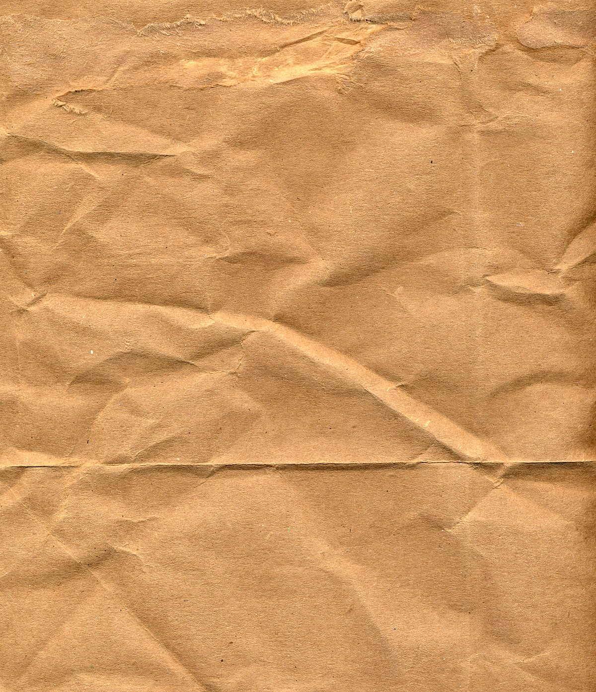


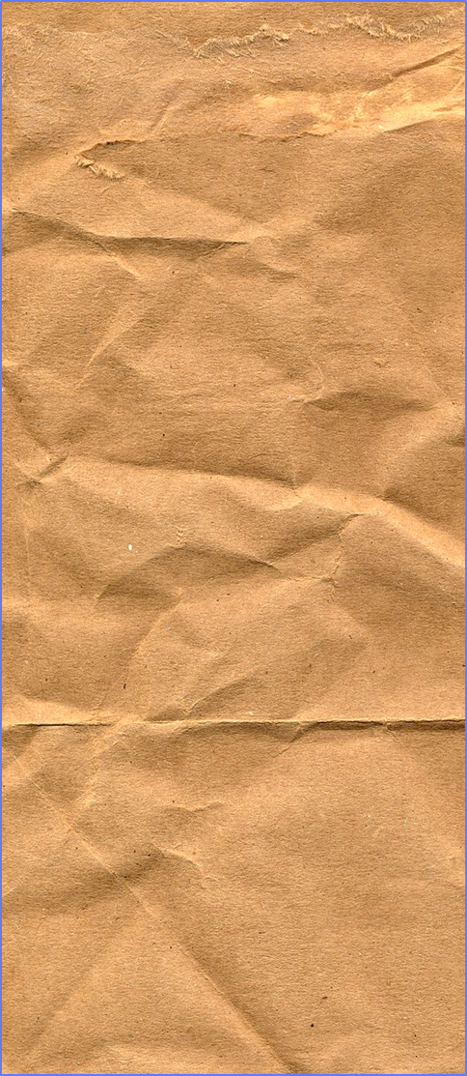
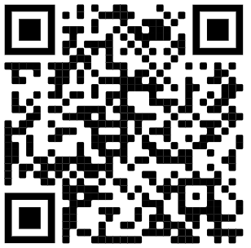
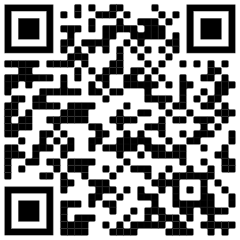

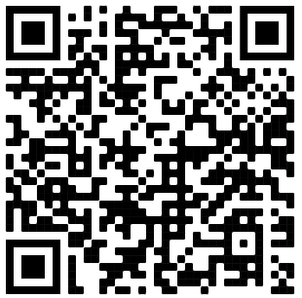
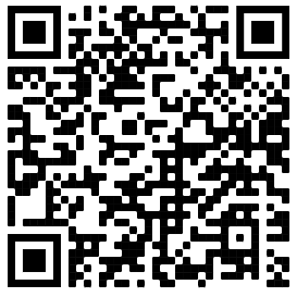
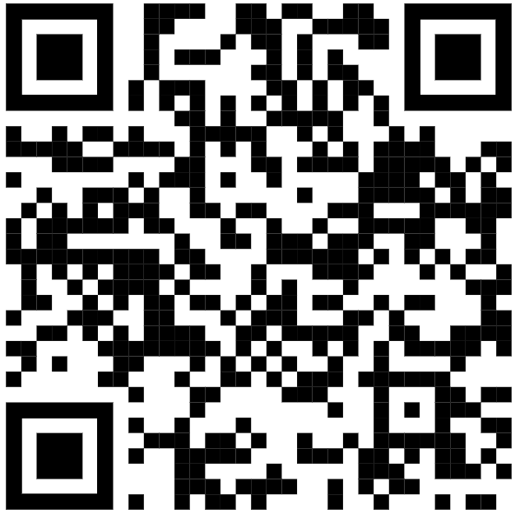

GCSE Art
How is your GCSE marked?
-24 marks given to each Assessment objective
-60% Coursework and 40% Exam
Techniques list:
try some of these ideas to add to your coursework to help with AO1 & 2!
Fine liner and water (ink & wash)
Working onto different backgrounds (tea stained, tissue paper, collage)
Watercolour
Acrylic paint
Coloured Pencil
Chalk / charcoal on brown paper
White pencil on black paper
Mark-making tonal shading
Painting on fabric or cardboard
Oil Pastel
Coloured chalk pastel
Biro (You can use different colours too)
White Gel pen
Poly-printing
Mono-printing
Freehand machine sewing
Continuous line drawing
Wax resist
Ink
Bleach and ink
Ink and emulsion
Image transfer
Photography
Drawing with wire
3D relief techniques
Collage
Printing with textured paper
Try each technique, be brave and experimental!
Art & Design Specific Information
Assessment objectives | What can you do?
 | -Artist research pages -Visit galleries and exhibitions -Your own response in the style of an artist -Annotate your artists work with the knowledge you have learnt.
 | -Experiment in response to your chosen artists. -Explore a range relevant materials and techniques. -Experiment with NEW materials, tools and techniques. -Try out different combinations of tools (think outside the box!) -Practice and refine your skills of your chosen media, tools and techniques.
 | -Title page -Mind map (with images/ drawings) -Mood-boards --Photographs (Contact pages) -Observational Drawings -Sketches -Designs -Detailed diagrams -Edits of images or work on photoshop
 | -Plans and drawings of final piece ideas -Mini mock-ups and experiments for final piece. -Creating an original final piece, that is clearly inspired by your research and creative journey.
Brief Overview
You are to explore, through a range of two-dimensional and/or three-dimensional processes and media, practical application of skills and relevant critical and contextual sources such as the work of contemporary artists, craftspeople and designers and the different purposes, intentions and functions of art, craft and design as appropriate to your own work.
They even contain QR codes to helpful videos.
Independent investigations- Finding your own artists!
Tate Art Guide Sketchbook ideas
Grade 9 Videos of Student Sketchbooks

Slide 4
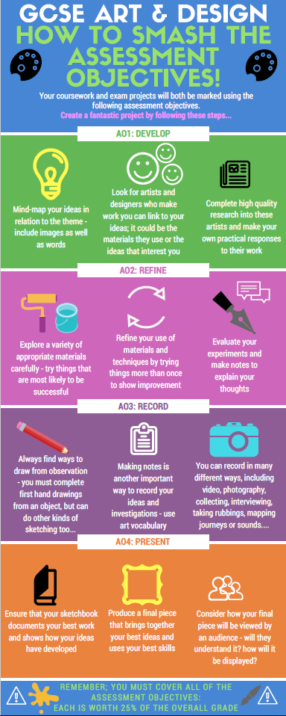
Helpful Bookmark
Breaks down each of the assessment objectives.
Gives you useful suggestions on how you can achieve and add to each of the different assessment objectives.
Helpful when there is an area that you are lacking work in to help boost your marks.

Slide 5
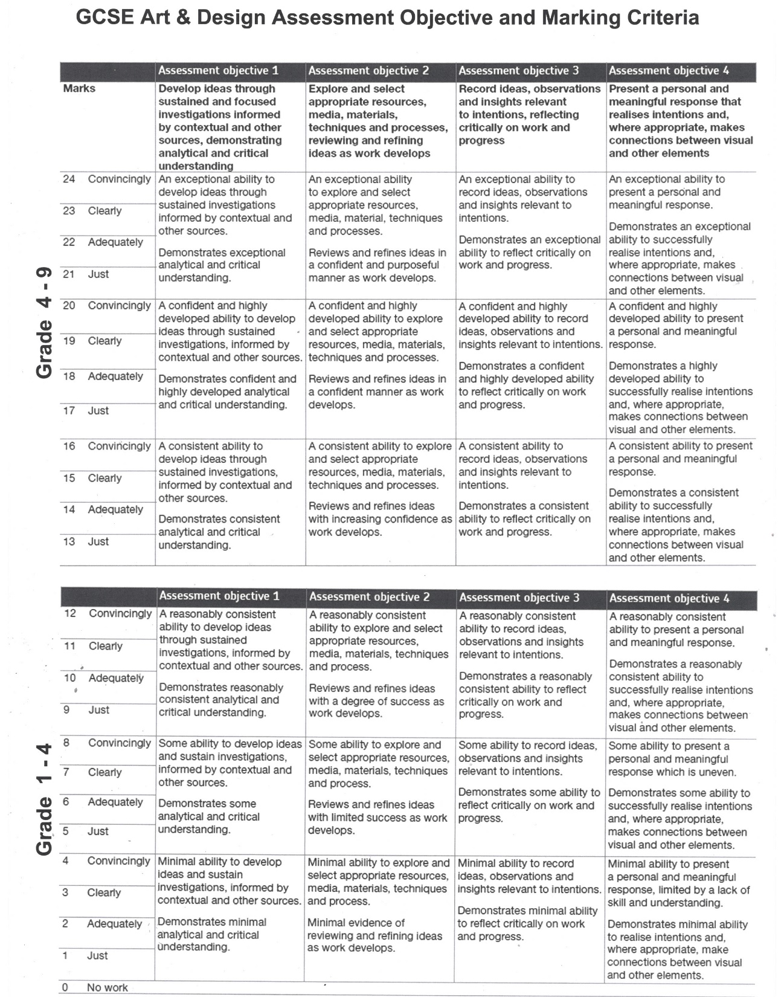
It is useful to familiarise yourself with the assessment objectives marking criteria.
Look at the wording and assess yourself on where you would mark yourself under each objective.
This is what is used when moderating your work at the end of the course

Slide 6
Useful Websites/Pages to Visit
Julia Stubbs: A compilation of exemplar material spanning eight years, from 2004 to 2016. Past GCSE Art & Design students created these works for their final exam. Each student's name is a hyperlink to their work. Next to their name, you'll find their grade and point percentage. You may click on each student's name to visit a gallery of their work. Don't forget to check out the sketchbook entries at the lower right side of the page!
Pinterest: There is no better way to understand what excellent work looks like than by looking up posted sketchbooks. Talented students routinely post to Pinterest and other social networking sites. Past sketchbooks can also provide inspiration for how to present your work and inspirational artists.
YouTube: This platform hosts many videos particularly interesting to GSCE art students. You may search the site to find students showing their work, page by page. They narrate their work in loving detail while pointing out their less noticeable features.
Some of the best advice provided include the importance of focusing on quality rather than quantity. These students aver that you should not be afraid to experiment and even make mistakes. That way, the examiners can see your process; the steps you've taken to create your works of art. They'll impress upon you that an excellent sketchbook doesn’t have to be tidy.
Your Paintings – Art: This excellent resource makes it possible for art lovers and students alike to discover the contents of the UK's National Collection of oil paintings. Search for information on the lives and work of thousands of artists, discover where you can view important artworks in person and find resources which are specifically aimed at schools. The guide to artistic styles and movements provides an excellent introduction to over 40 different artistic styles and movements.

