Slide 1

Revising for Component 3
BTEC Tech Award in Travel and Tourism

Slide 2
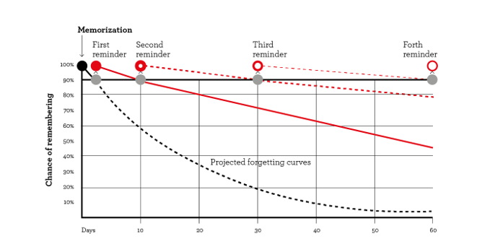
Why is revision/retrieval so important?

Slide 3
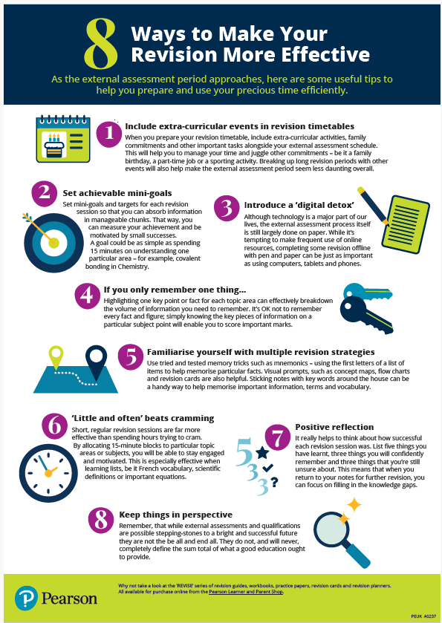
Tips from Pearson
Here are some tips from your
exam board.
These will help you revise more
effectively.

Slide 4
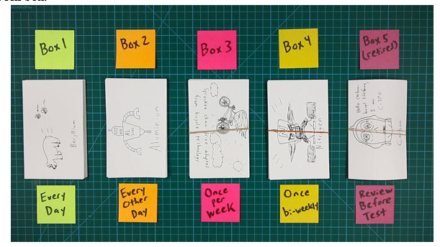
Using flashcards
Flashcards are very good if used properly. In the Leitner System, you make a bunch of flashcards and test yourself with them the next day. If you can remember the information using only the prompt, you move the flashcard into a separate box, labelled “1 week” along with the date that you put them there. If you did not remember the flashcard, you put it in a box labelled “1 day”. The next day, you repeat the process, hopefully moving the flashcards from the 1 day box to the 1 week box.

Slide 5
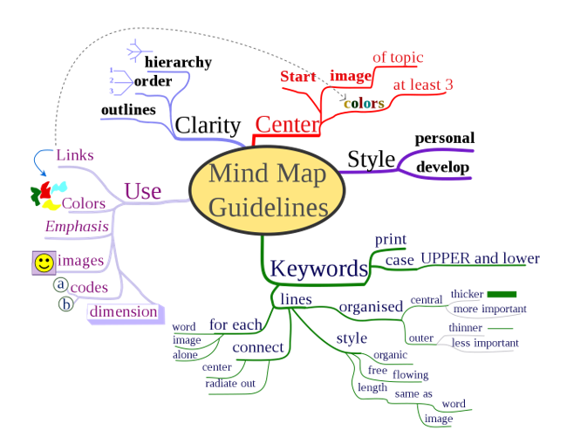
Using mind maps
Mind maps are an excellent way of listing key ideas and notes in a visual format. Mind maps are also excellent at showing the links between topics and ideas.
There are many different forms of mind maps, but they have several things in common. They all start with a central concept, word, or idea in the centre. From there, you branch out things that are related to that concept. You should use colour and images to make the map more visually appealing and easier to remember.
Mind maps are also good because they are quick to make and can be done as a good exercise at the start of your revision session. In addition, the best mind maps should be done by hand, making them natural and organic; easier for your brain to remember.

Slide 6
To revise for comp 3, using flash cards, mind mapping etc are important to understand the content. Without the content, you will struggle in answering the questions in the exams.
Make sure you know the command words for the exam, so that your answer addresses the question. Spend some revision time looking at exam papers and mark schemes.

Slide 7
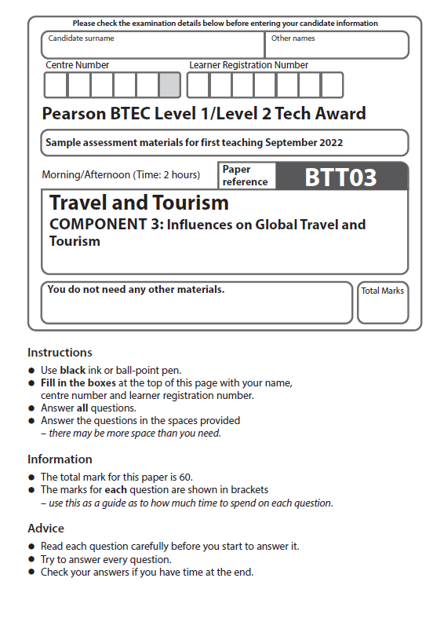
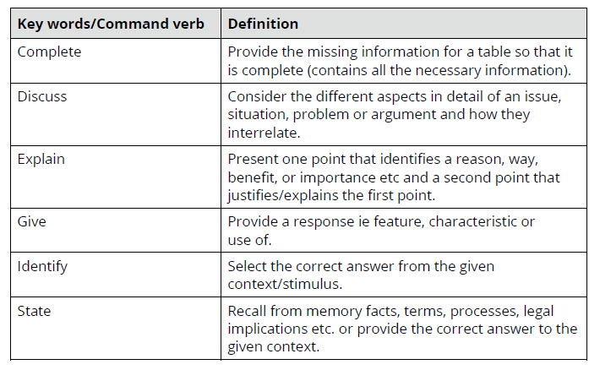
What are the command words for Comp 3?

Slide 8
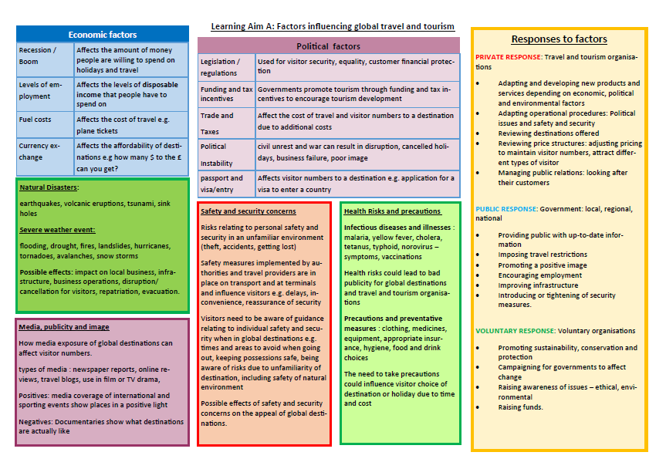
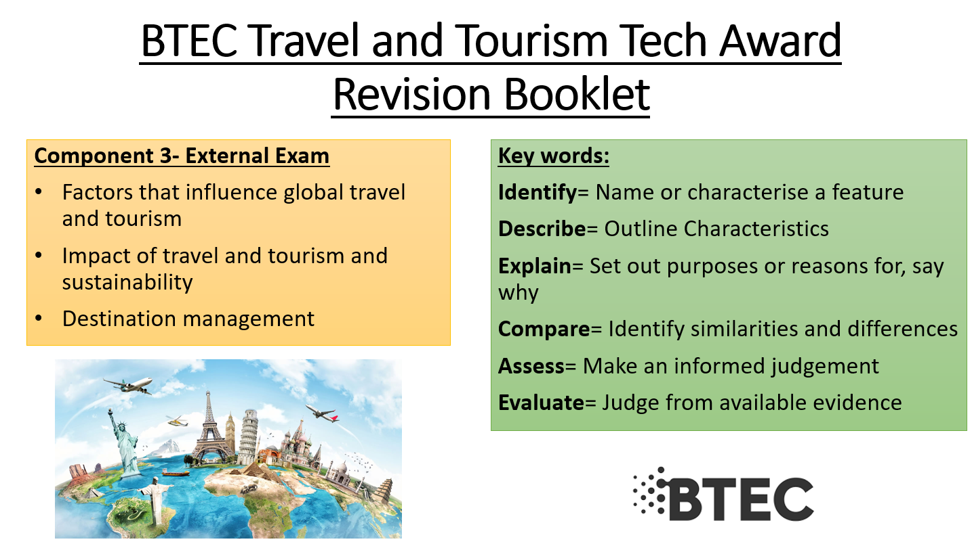
Finally, use the materials on TEAMS to support your revision

