Slide 1
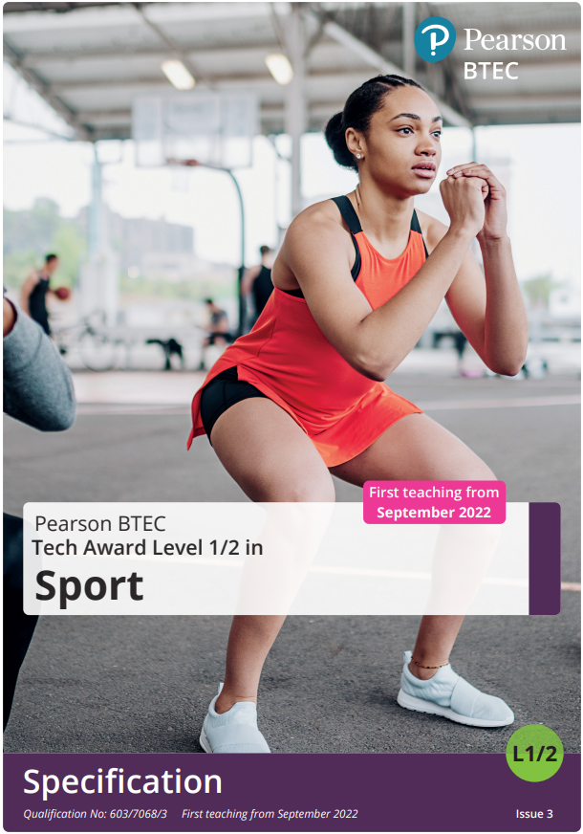
Revision tips for Btec Sport

Slide 2
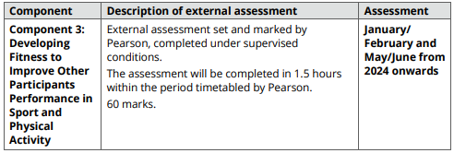
Component 3 Exam – 40% of your final grade
Variety of question styles from 1 mark multiple choice & 1 term answers, through to 6 mark extended answers

Slide 3

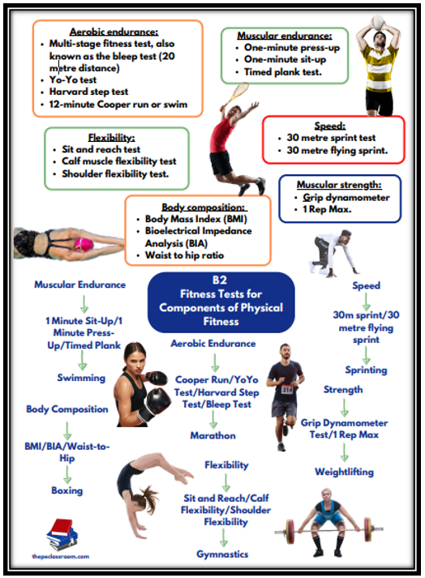
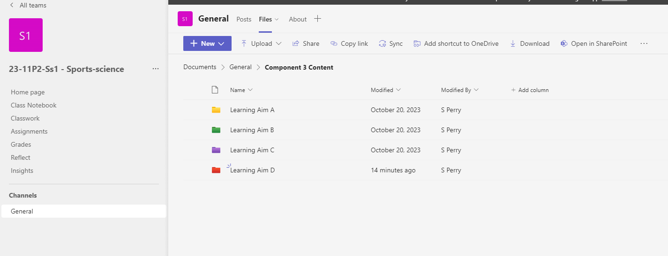
Revision Tools
Your CGP Revision Guide
Knowledge Organisers
TEAMs Class channel
Youtube
The Specification

Slide 4
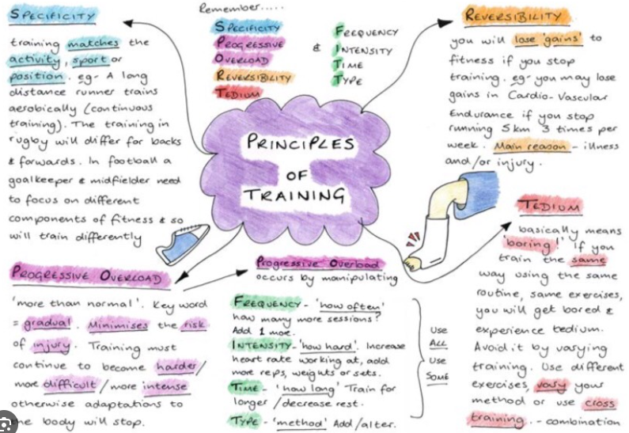

Revision Ideas
Notes
Flash Cards
Mind Maps
Past exam material (though currently a limited amount available)

Slide 5
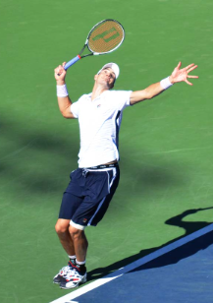
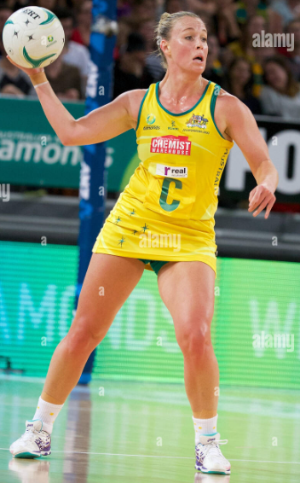
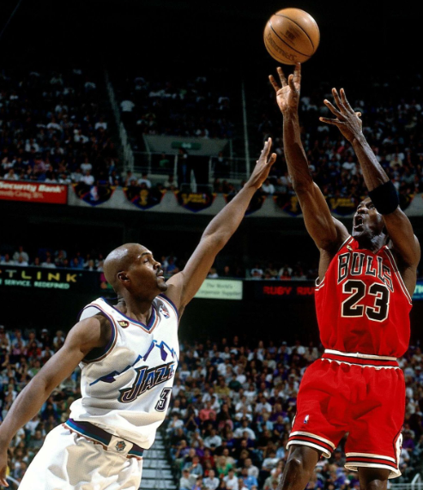
PE Specific
Know your key terms! For example, know the difference between your skill related components of fitness, and health related components of fitness
Think about the what, when, why and how:
WHAT is it?
WHEN is it used in sporting actions?
WHY is it used in sport?
HOW does it impact performance?

Slide 6

Top 10 Tips for Revision
https://www.youtube.com/watch?v=JQI7SvS6g1M

