Slide 1

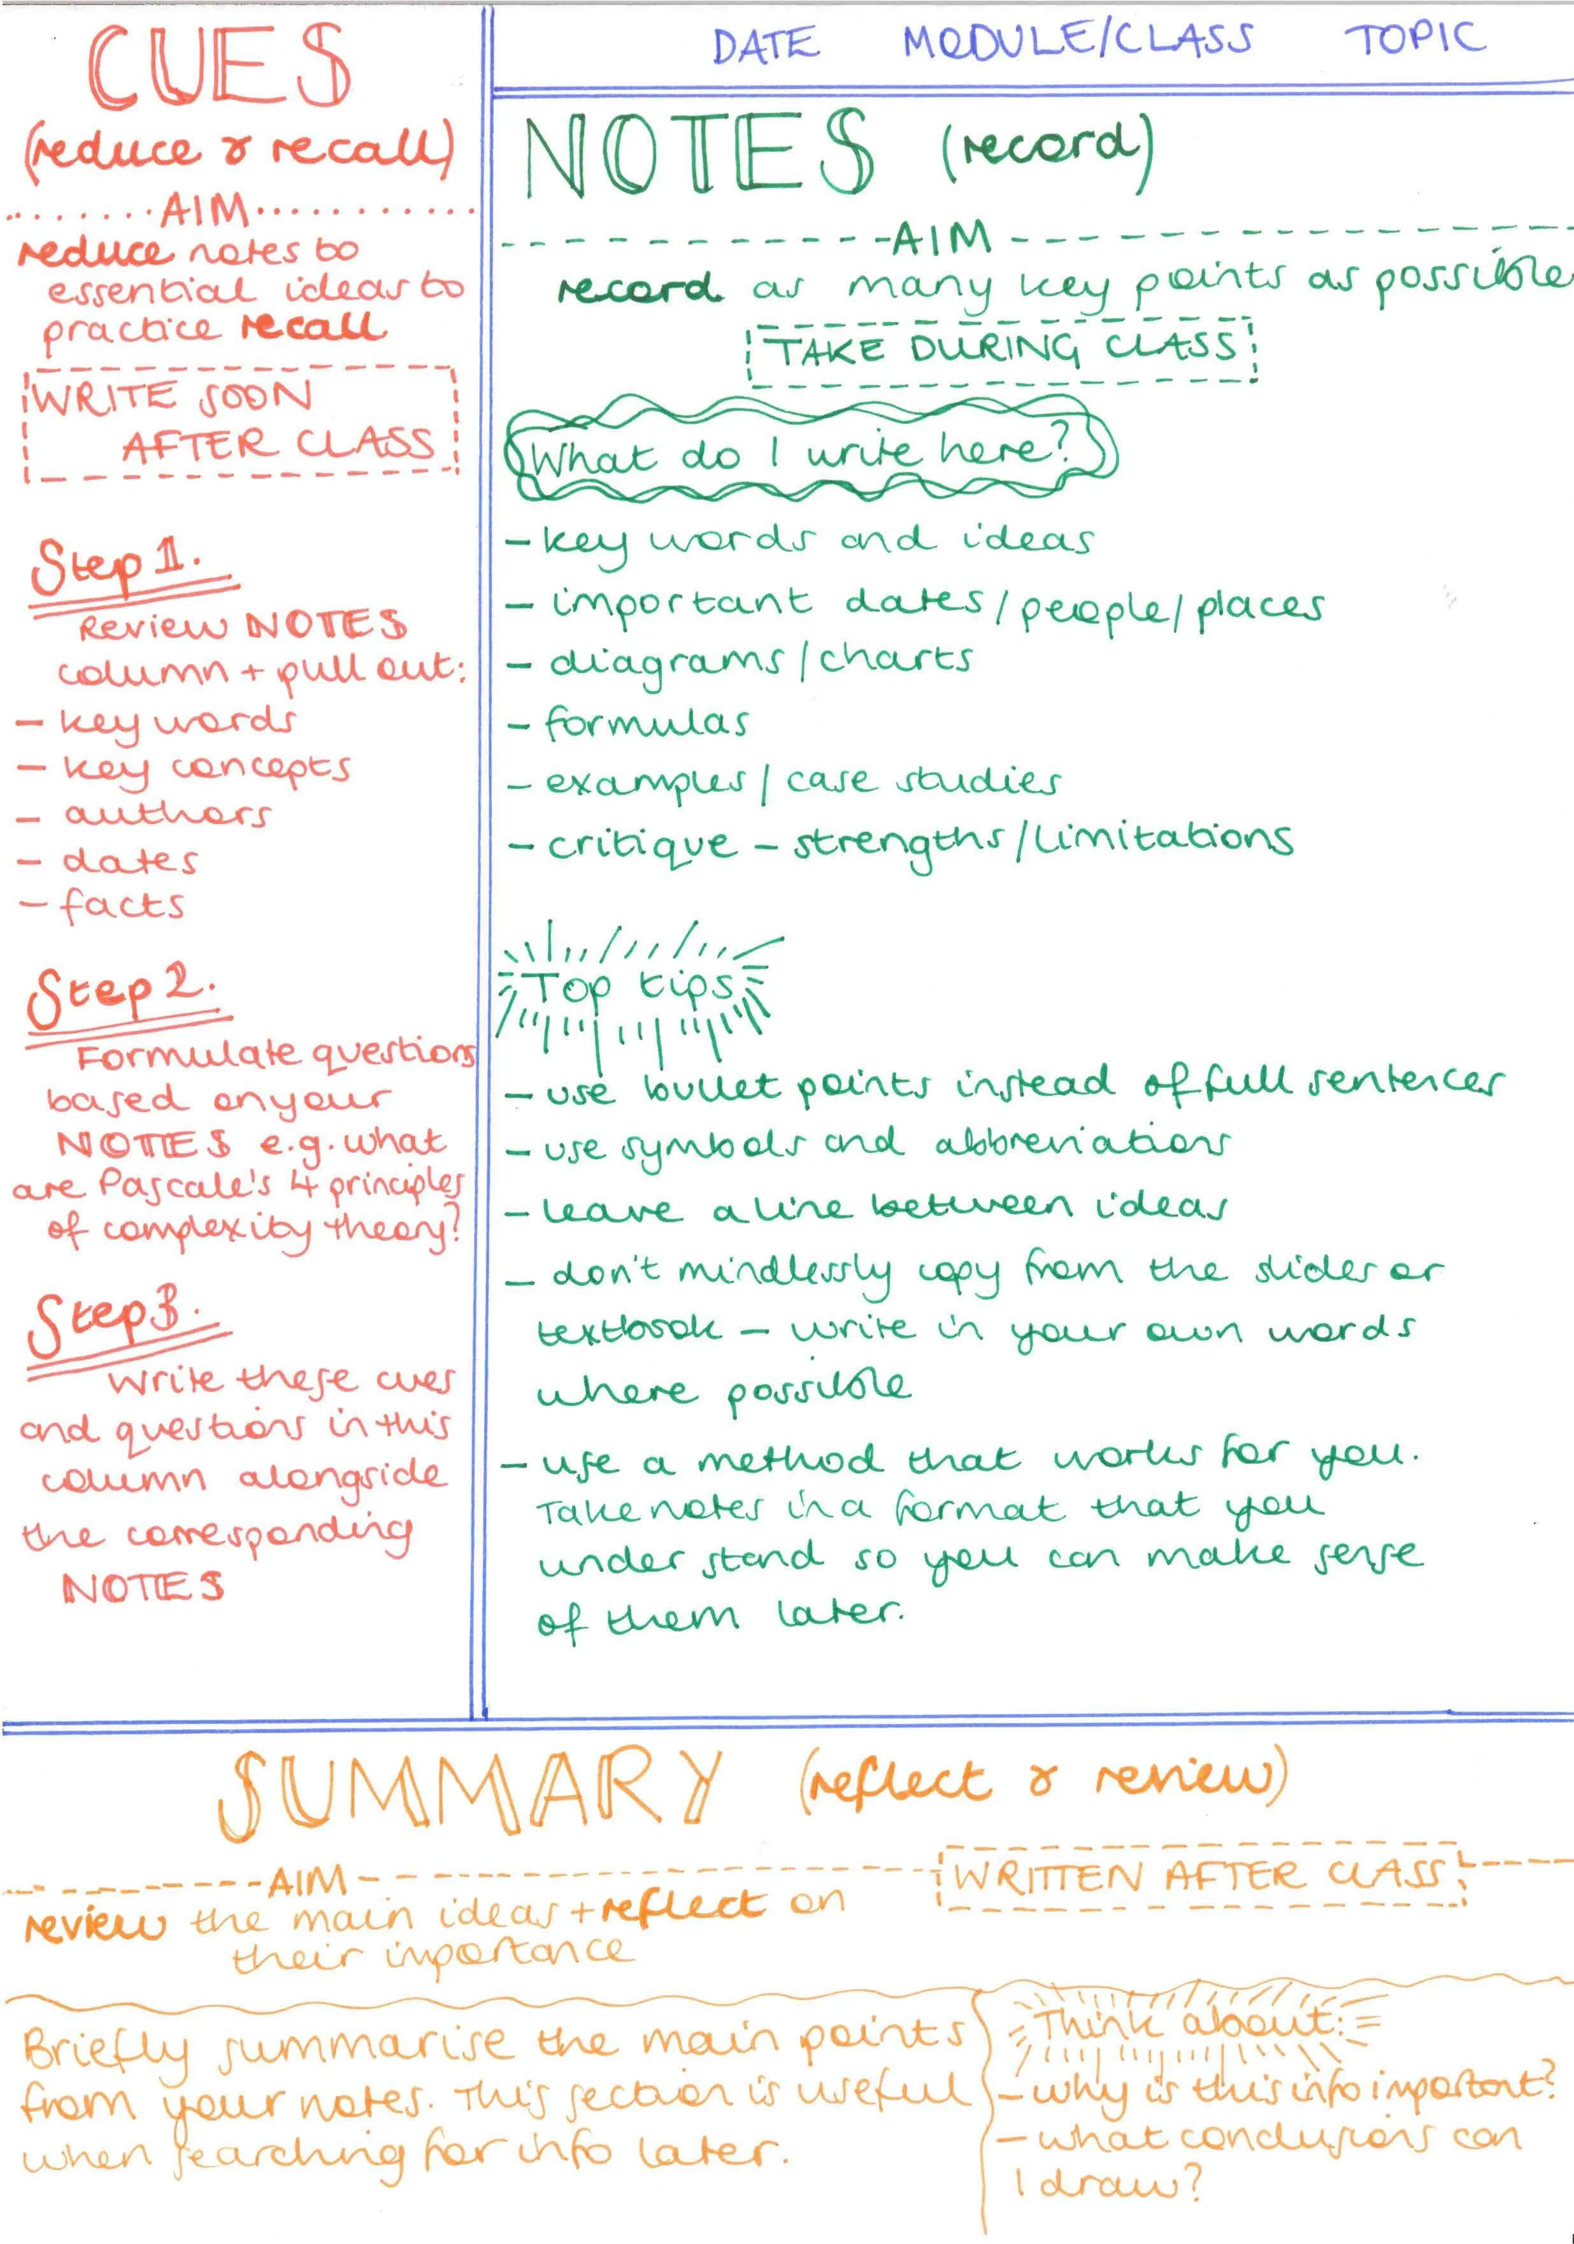
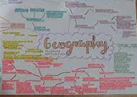

Geography
What do I need to revise…
Learn the theories and the case studies/examples.
Use your books, KO’s, revision guides, BBC Bitesize, GCSE Pod, Seneca (make sure you have the correct case studies!)
How to start…
Write a list of subheadings for that topic.
Mind maps or revision clocks- each map is a different subheading. Use images, colour and quick sketches.
Cornell note taking
Flashcards
Quizzing
Revision booklets
“AQA GCSE Geography specification”

Slide 2

Geography keywords…
Look, cover, copy.
Revise keywords in order e.g. when trying to remember the formation of a waterfall or trying to remember the opportunities in Lagos.
Highlight keywords within your note take and again in your answers.
Practise exam questions…
Online past papers “AQA Geography GCSE past papers” 2016 onwards.
Practise the ones you aren’t confident on first.
Time them (a mark per minute e.g. 6 marks= 6 minutes).
Read the mark schemes or check your notes.
Repeat the question again in a few days time.
Exam tips…
Use the figure and/or a case study if it says “use your own knowledge”.
Explain points 2 or 3 times.
If you don’t know a question- highlight the keywords and talk about anything you know about that keyword.
1, 2, 3, 4, 6, 9 marks?
Waterfall formation
Hard and soft rock
Hydraulic action and abrasion
Plunge pool
Overhang
Collapse
Gravity
………

Slide 3
Command word | Marks | How to…
State | 1, 2 | Define, say what you know about the question
Outline Describe | 3 4, 6 | Say what you know about the question, don’t need to explain why
Explain (when it doesn’t ask for an opinion or agreement) | 6 | 3 x PEELs explaining why you think what you think Don’t need an “on the other hand”
Explain (when it asks for an opinion or agreement) | 6 | 1 x PEEL explaining why you think what you think 1 x PEEL explaining an opposing argument Conclusion
Explain (when it asks for an opinion or agreement) | 9 | 2 x PEEL explaining why you think what you think 2 x PEEL explaining an opposing argument Conclusion
Suggest Justify | 6 | 3 x PEEL- can be one sided (so no “on the other hand”)
Suggest Justify | 9 | 2 x PEEL explaining why you think what you think 2 x PEEL explaining an opposing argument Conclusion
Discuss To what extent Evaluate | 6 | 1 x PEEL explaining why you think what you think 1 x PEEL explaining an opposing argument Conclusion
Discuss To what extent Evaluate | 9 | 2 x PEEL explaining why you think what you think 2 x PEEL explaining an opposing argument Conclusion
Assess | 6 | 1 x PEEL explaining the biggest reason 1 x PEEL explaining least biggest reason Conclusion- why this order?
Assess | 9 | 1 x PEEL explaining the biggest reason 1 x PEEL explaining second biggest reason 1 x PEEL explaining least biggest reason Conclusion- why this order?

