Slide 1


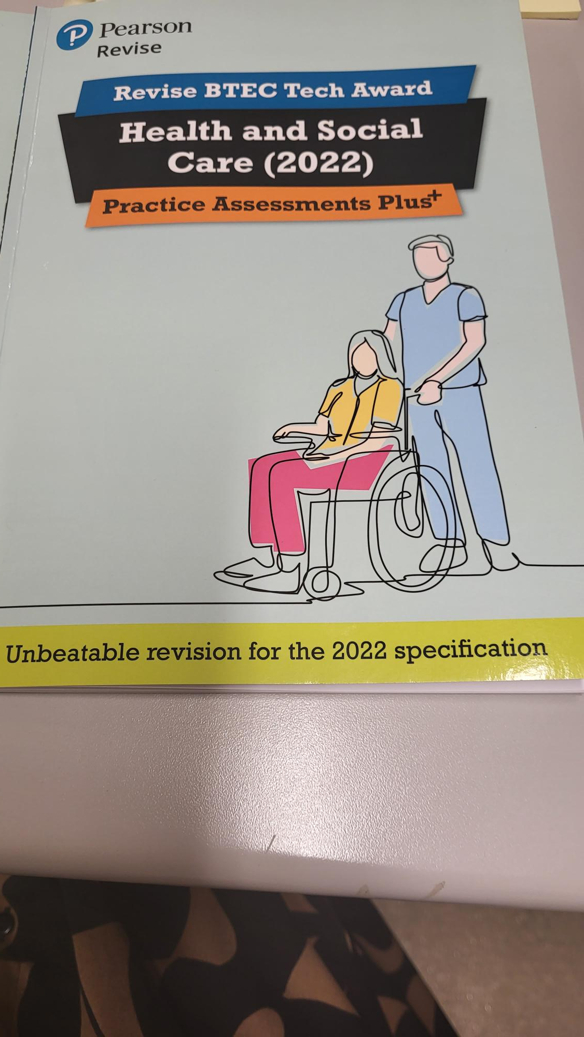
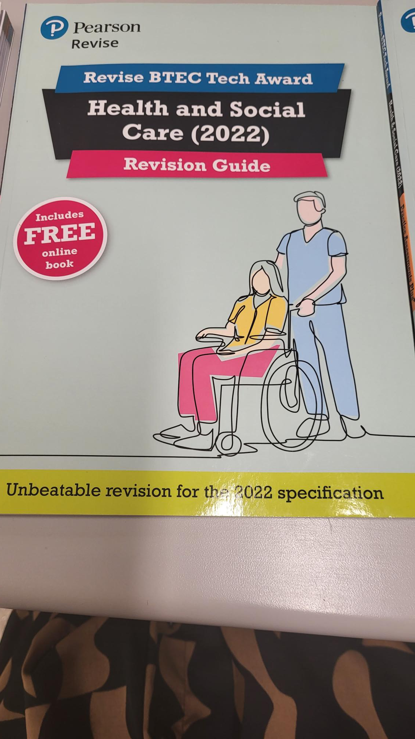
Pearson's BTEC Tech Award Level 1 / 2 Health and Social Care
Component 1: Human Lifespan development
Component 2 : Health and Social Care services and Values
Component 3 : Health and wellbeing

Slide 2

Component 3 External Exam – Health and Wellbeing
When revising you can use techniques like:
Retrieval tasks
Mind maps
Flash cards
Past Papers
Exercise books

Slide 3









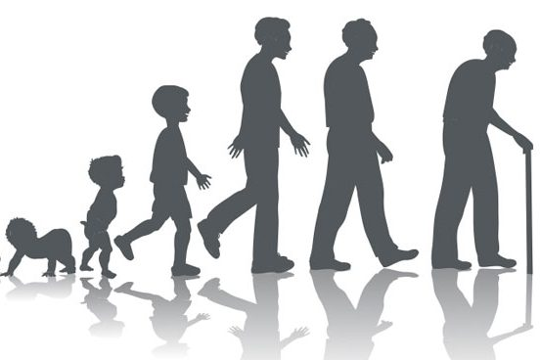


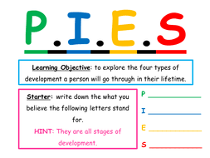






Component 1: Human Lifespan and Development Knowledge Organiser
Use your knowledge Organisers
Topic Content:
You will study the areas of growth and development that contribute to the whole person considering PIES
Will reflect on the factors that impact on everyone’s life e.g. lifestyle culture etc.
Learning Objectives
A – Understand the different types of health and social care services and barriers to accessing them.
B – Understanding the skills, attributes and values required to give care.
Key terms –
Characteristics
Life stages
Growth
Classification
Development
- Physical
- Intellectual
- Emotional
- Social
Gross Motor Development
Fine Motor Development
Inherited conditions
Supportive
Unsupportive
Cultural factors
Gender Roles
Housing
Pollution
Life events
Expected events
Unexpected events
Informal support
Professional support
Voluntary Support
Multi-agency working
Multidisciplinary
LAA – Understand human growth and development across life stages and the factors that affect = it.
Main life stages
Factors affecting growth and development
Inherited conditions – are as a result of genes that are passed from a parent/parents to their child.
Illness and disease – Chronic or serious illness during their lifetime that impacts their growth and development.
Mental ill health – It affects the way a person feels about themselves and how they interact with others.
Disability – Something that may limit an individual’s ability to carry out some activities.
Sensory Impairment - Partial or complete loss of one of the sense e.g. sight, hearing, touch or taste.
Lifestyle – Choices people make about their lives e.g. Smoking, Alcohol consumption, substance misuse, exercise.
Emotional – Someone’s feelings – emotions change depending on life experiences and decisions.
Social – Relationships with others supportive/unsupportive
Cultural – The religious/cultural and community groups people belong to.
Gender roles – roles and responsibilities determined by a person’s gender
Environmental – Our surroundings and conditions which we live in, could be your home, community, air around us.
Economic – A person’s employment situation and their financial resources.
Age Group | Life stage | Developmental progress
0-2 years | Infancy | Still dependent on parents/carers but growing
3- 8 years | Early Childhood | Becoming increasingly independent, improving thought processes and learning how to develop friendships
8-18 years | Adolescence | Onset of puberty, growth spurts and emotional changes.
19-45 Years | Early Adulthood | Leaving home, making your own choices about family and career
46-65 years | Middle Adulthood | Having more time to travel, socialise and take up hobbies as any children may be leaving the home, beginning of menopause and ageing process.
65+ years | Later Adulthood | The ageing process continues which may affect memory and mobility.
P – Physical – how a body grows and changes and how their motor skills change
I – Intellectual - how people develop cognitive abilities (thinking skills) such as memory/recall and language.
E – Emotional - describes how people learn to cope with their feeling towards themselves and others
S – Social – describes how people form relationships and learn how to be independent.

Slide 4

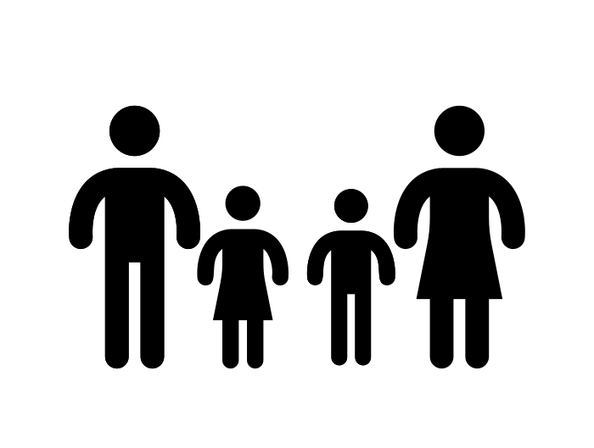








Component 1: Human Lifespan and Development Knowledge Organiser
Challenging texts
Use your knowledge Organisers
Topic Content:
You will study the areas of growth and development that contribute to the whole person considering PIES
Will reflect on the factors that impact on everyone’s life e.g. lifestyle culture etc.
Learning Objectives
A – Understand the different types of health and social care services and barriers to accessing them.
B – Understanding the skills, attributes and values required to give care.
Scan the QR code for the specification document
Life events can be expected: you would expect this event to happen to you in your lifetime, or unexpected: you would not expect this event to happen to you in your lifetime. Unexpected life events are harder to adapt to because you do not expect them to happen.
Support comes in three different types.
Informal support is the everyday type of support a person would receive. Informal Support is unpaid.
Support can also be formal , people who provide formal support are paid for their service. Such services could be doctors, midwives speech therapists etc.
Voluntary Services offer support , free of charge, in many different forms, such as support groups help lines and advice groups. Voluntary groups rely on donations from the Government and the public.
Informal
Formal
Voluntary Services
Friends, family and neighbours
Life circumstances
Like the other life events , life circumstances can be expected and unexpected.
Expected life circumstances include, leaving school, getting a job, moving out of parents house, moving home and retirement.
Unexpected life events would include, being excluded from education, periods of unemployment due to redundancy, loosing a job
Changes in living conditions and standards. In addition, due to life choices a person may find themselves imprisoned
Types of support available
GP, Counsellor and therapists
You need to explain what support a person has, how the support works and how the support enables the person to adapt to the life event.
Positive: The support an individual receives enables them to adapt to their new circumstances and the development of their PIES is not impacted in the long term.
This is because all four types of support are available, and the individuals confidence and self-esteem is maintained or even improved. The individual is well informed and can feel secure that they have a support network to help them during the adjustment period.
Negative: There is either a lack of support or ineffective support for the individual to access. This can lead to negative state of mind, anger, withdrawal or mental health issues. Ultimately the individual is unable to adapt both mentally and physically and the development of their PIES is impacted both in the short and long term.
Charities, CAB, Church organisations, helplines, support groups.
You need to explain what support a person has, how the support works and how the support enables the person to adapt to the life event.

Slide 5
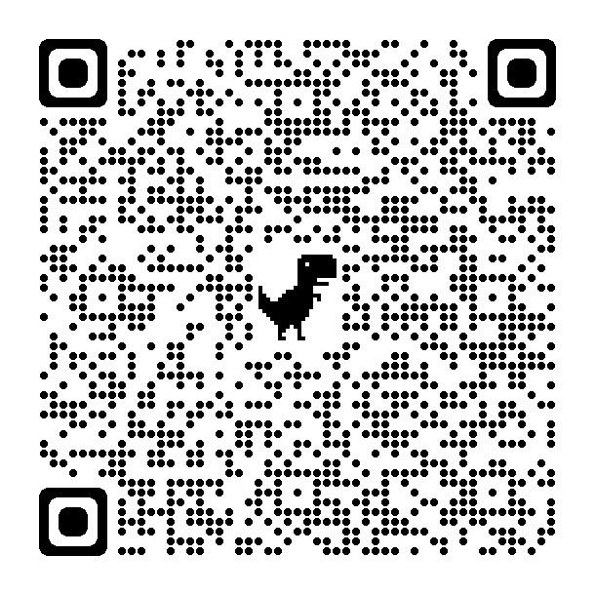
Component 2: Health and Social Care Services and Values Knowledge Organiser
Challenging texts
Use your knowledge Organisers
Topic Content:
You will learn a range of health and social care services, any barriers individuals face accessing them and how they can be overcome.
You will learn about the skills, attributes and values required to give care.
Learning Objectives
A – Understand the different types of health and social care services and barriers to accessing them.
B – Understanding the skills, attributes and values required to give care.
LAA – Understand the different types of health and social care services and barriers to accessing them.
Health Conditions –
Type 2 Diabetes
  The Sugar levels (glucose) in the blood become too high (7 mmol/l +)
  Symptoms include – headaches, thirst, urinating a lot, blurred vision/tiredness
Arthritis
  Affects the joints.
  Symptoms include stiffness in joints, swelling around the joint, pain/tenderness, warmth around the joint.
Coronary Heart disease
  When fatty substances build up in the coronary arteries making them narrower and restricting blood flow to the heart.
  Symptoms include chest pain, feeling dizzy, nausea (sick) and shortness of breath
Dementia
  Reduced brain function resulting in memory loss.
  Symptoms include understanding and processing difficulties, difficulties in speech, loss of independence etc. these progressively get worse.
  1 in 14 people over 65 have dementia
Cerebral Vascular Accident
  Interrupted flow of blood to the brain caused by either a stroke or brain injury.
Obesity
  Someone with a high level of body fat.
Asthma
  A chronic life threatening condition which affects the lungs.
  Symptoms include breathlessness, wheezing and coughing.
Chronic Obstructive Pulmonary Disease
  An inflammation of the lungs which obstructs (reduces) airflow.
  Symptoms include breathlessness, chesty cough, wheezing, frequent chest infections and tiredness.
Scan the QR code for the specification document
Additional Needs - Extra support needed to ensure good standard of living and quality of life.
Sensory Impairment –
  Vision/Hearing difficulties which significantly impact communication and well-being.
Learning Disability
  Less able to understand complex information and learn new skills.
Physical Disability
  “A limitation on a persons’ functioning, mobility, dexterity or stamina that has a substantial and long-term negative effect on an individual’s ability to do normal daily activities” – Equality Act 2010
Key terms –
Formal Support
Informal Support
Type 2 Diabetes
Arthritis
Coronary Heart Disease
Dementia
Cerebral vascular accident
Obesity
Asthma
Chronic Obstructive Pulmonary Disease
Primary Care
Secondary Care
Tertiary Care
Allied Health Professionals
Respite Care
Domiciliary Care
Residential Care
Informal Carers
6 C’s
Primary Care – First point of contact with the NHS.
e.g. GPs, Walk-in Centres, Dentist etc.
Secondary Care – When you need more can than a primary service can provide. E.g. Cardiology, Endocrinology – they usually support diagnosis and treatment.
Tertiary Care - Advanced specialists who are highly skilled and experiences. E.g. complex surgeries i.e. Brain, etc.
Allied Health Professionals- They support people who are experiencing both mental and physical health problems. They must be registered with the Health and Care Professions Council (HCPC) e.g. Paramedics, dieticians, Art Therapists, Speech and Language Therapists etc.
Services for children and young people.
Foster Care – provides a safe environment for children who for whatever reasons can’t be at home with their family. Can be short-term or long-term.
Residential Care – best for people with complex needs – provides high quality care.
Youth Work – Supports young people between 11-25. Helps with personal and social development.
Informal Social Care
Informal Carer – family or friends.
Charities - Voluntary organisations that support individuals and their families e.g.. Homestart.
Faith-based groups – Supporting Individuals who share religious or Spiritual beliefs e.g. Islamic relief.
Community groups – Support within the community. E.g. Food banks
Types of Care.
Respite – Short term care which provides relief to families who provide full time care. This can be at home or in a residential care home.
Residential – Living in a setting instead of your home. Accommodation, Laundry and meals are all provided. Staff are specifically trained to support individuals 24 hours a day.
Domiciliary – Care workers visiting the home of an individual to support them with daily living e.g. Personal Care.

Slide 6
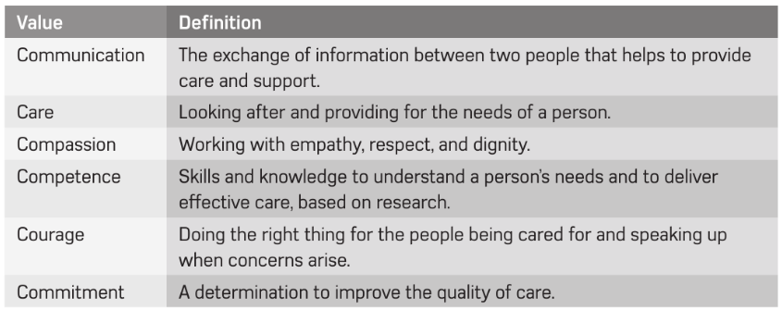


Component 2: Health and Social Care Services and Values Knowledge Organiser
Scan the QR code for the specification document
Use your knowledge Organisers
Topic Content:
You will learn a range of health and social care services, any barriers individuals face accessing them and how they can be overcome.
You will learn about the skills, attributes and values required to give care.
Learning Objectives
A – Understand the different types of health and social care services and barriers to accessing them.
B – Understanding the skills, attributes and values required to give care.
LAA – Understand the different types of health and social care services and barriers to accessing them.
Barriers – stop people being able to access a service. Meaning people miss appointments, treatments and support.
LAB - Understanding the skills, attributes and values required to give care.
Skills and Attributes in Health and Social Care
Problem Solving
Observation
Dealing with difficult situations
Organisation
Empathy
Patience
Trustworthiness
Honesty
Values in Health and Social Care
Barriers to accessing Services | Overcoming Barriers
Physical – something that stops someone physically accessing the service they need. E.g. Stairs into a GP surgery | Special adaptations which enable someone to access the service they need e.g. wider corridors to allow wheelchair access.
Sensory Barriers – something which reduces a persons’ ability to access a service due to a sensory impairment. E.g. not being able to hear what is happening around you due to a deterioration in hearing. | Adaptions put in place to support sensory barriers e.g. large print for sight impairments.
Cultural barriers – something which reduced a persons’ ability to access a service due to cultural beliefs, practices and needs. E.g. worrying they will be judged or not taken seriously because of their beliefs. | Proper training and collaborative approaches to understand cultures and beliefs to ensure that a persons’ wishes/needs are fulfilled e.g. enabling a Muslim to pray regularly during the day in a quiet and private setting in a hospital.
Language Barriers – something which reduces a person’s ability to access a service due to not understanding the words or language used. E.g. having English not as a first language. | Having adapted leaflets, translators etc to enable someone to access the information they need.
Geographical Barriers – Being unable to access a service due to location e.g. poor public transport in a village making it difficult to get to the local GP surgery. | Providing serviced which allow someone to access the service e.g. Phone Consultations with GP. Home visits.
Learning disabilities – being unable to fully understand complex information and make an informed decision without support. | Ensuring that adequate support is given to ensure that someone with a learning disability is supported to ensure that they are able to fully understand/make decisions e.g. Communication cards to help someone express emotions and preferences
Financial Barriers – Being unable to access a service due to money. E.g. not being able to afford care/therapies that will aid their condition. | Some charities and Local Authority provision can be put in place/claimed to help assist with reducing the financial burden that can be created.
Obstacles that individuals face
Lack of motivation
Self-esteem issues]
Stress
Previous bad experiences
Anxiety
Lack of support
Time constraints
Unachievable targets
Lack of resources
Disability
Health Conditions
Addiction
Benefits of skills, attributes and values.
High quality care
Person-Centred Care
Respect
Independence
Involvement in care decisions
Not discriminated against
Protected from harm
Able to raise complaints
Protected dignity and privacy
Rights promoted
Confidentiality maintained

