Slide 1

How can I effectively revise for English?

Slide 2
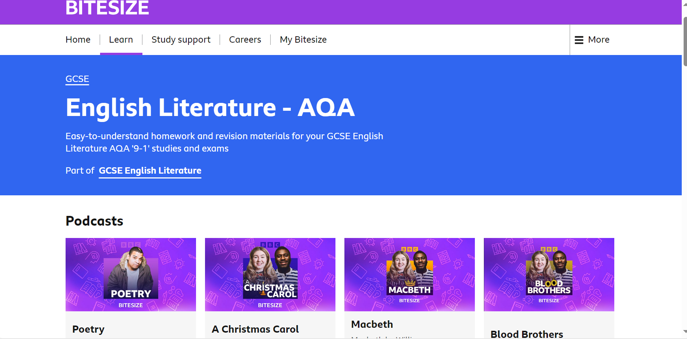
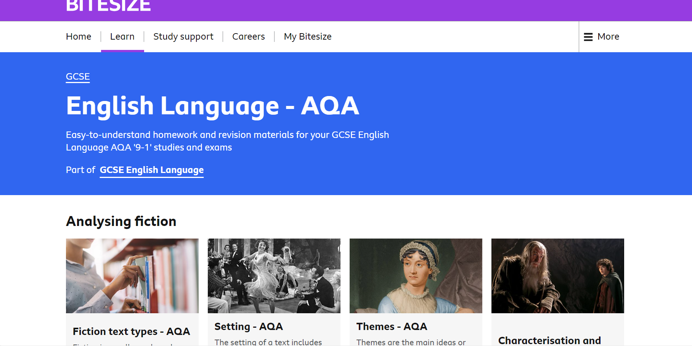
Online

Slide 3
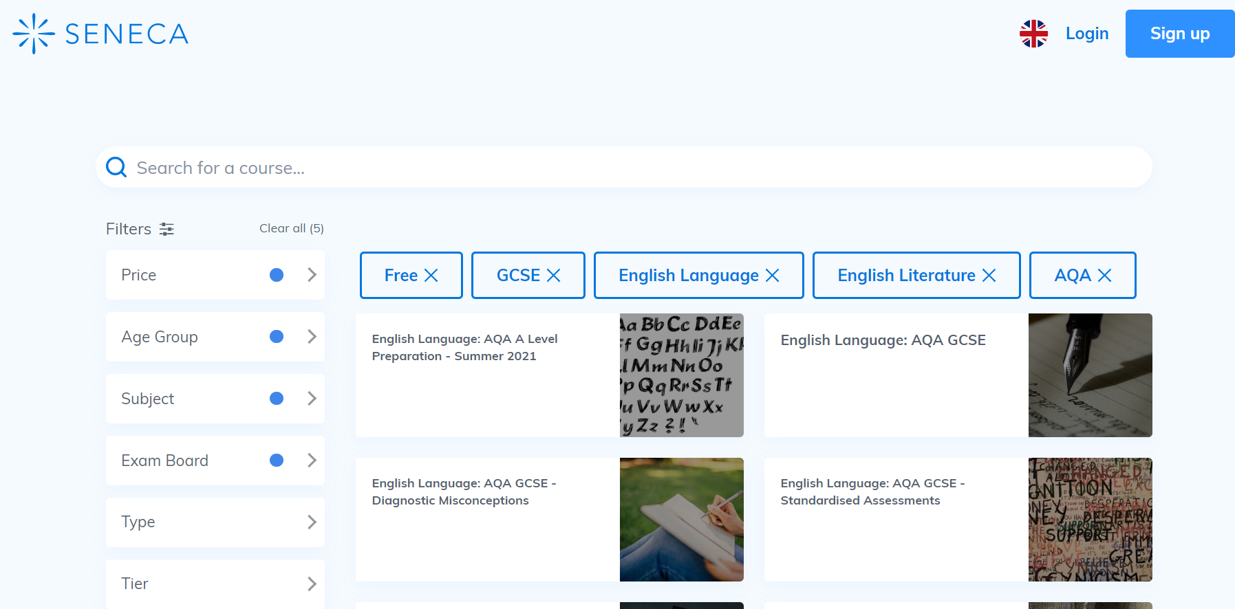
Online

Slide 4

Online

Slide 5
‘Exploding’ quotations:
3. Is there a key word/phrase/method employed by the writer?
- Identify the technique that has been used.
- What are the connotations of the key word?
2. Choose three words to describe the character at this point in the text.
4. What is the writer’s intention?
To teach/warn/criticise/celebrate…
Quotation goes here
Your quotation goes in here…
Contextualise the quotation:
Where in the text does it appear?
Who says it?
Who to?
5. Can you link 2 more quotations where the character/theme is presented in a similar way?

Slide 6
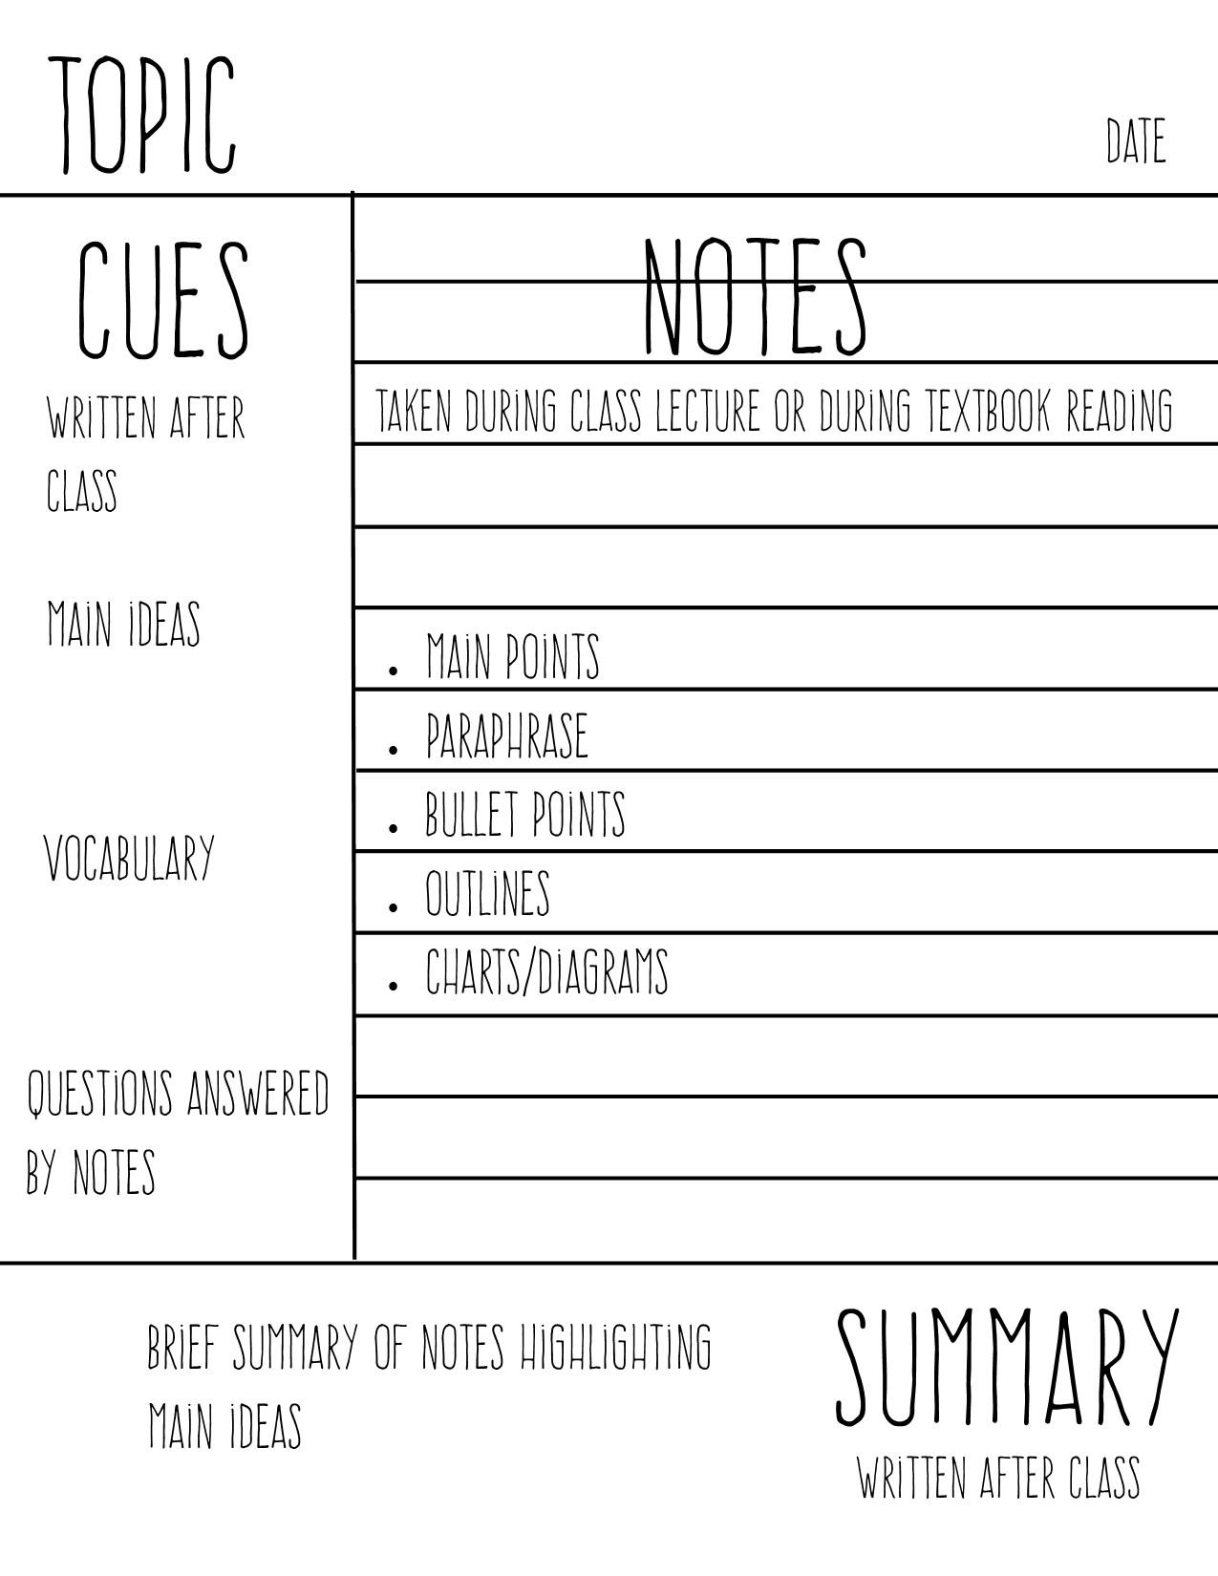
Cornell Note Taking

Slide 7
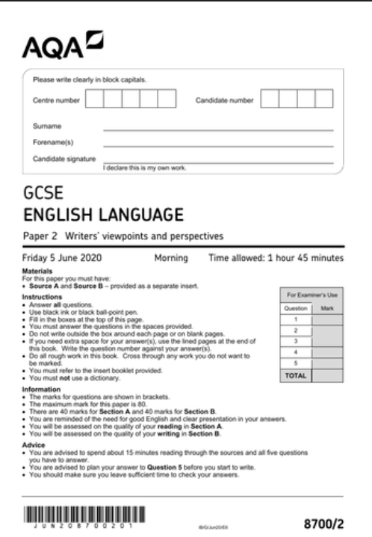
Past Papers

Slide 8
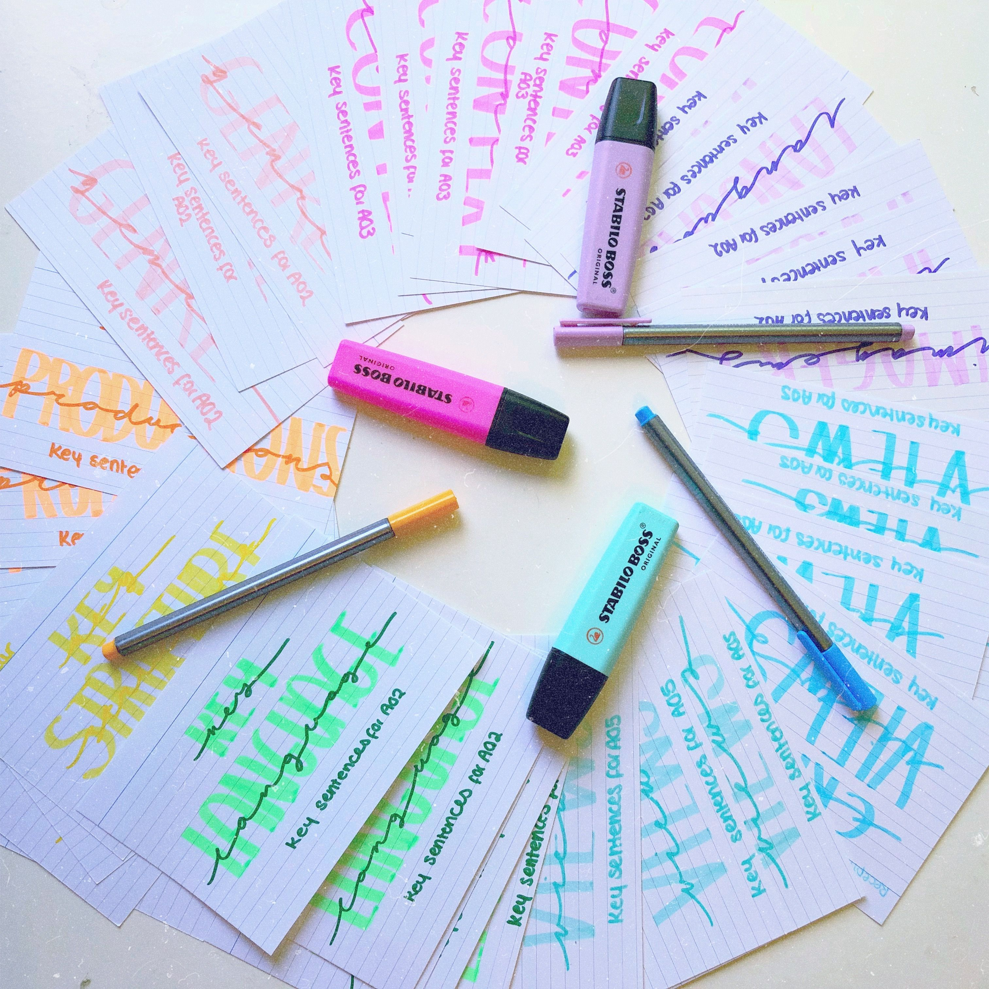
Revision Cards
Try to include the following for each poem:
A summary of the poem
3 key quotations (with key words and techniques identified)
2 points about structure of the poem
Comparison poem

Slide 9
Other tips to improve
Watch the news
Read more!
Use knowledge from other subjects
Practise writing umbrella statements
Finally, revise what you are least confident with first.

