Slide 1

How to revise….
GCSE Business
Notes:
Hello. This video is designed to talk you through how to revise for GCSE Business. If after watching the video you still have any questions, please speak to Mrs Pitcher.

Slide 2
Edexcel GCSE (9-1) Business
Specification
2 externally assessed exams
90 marks each
1 hour 45 minutes exams
3 sections, Section B and C require the use of case studies
Notes:
Firstly, it is very important if you are searching for any revision resources that you are looking for the correct GCSE Business specification. At St Peter’s we follow the Edexcel specification. The full spec is hyperlinked on this slide. The course consists of two exams. In 2024, the Theme 1 paper is on Tuesday 14th May and the Theme 2 paper is on Wed 5th June. Both exams are 1 hour 45 minutes in length, and follow the same layout. They both require students to use information from given case studies. This is a vital skill in Business and without use of context, students will struggle to achieve a grade 4.

Slide 3
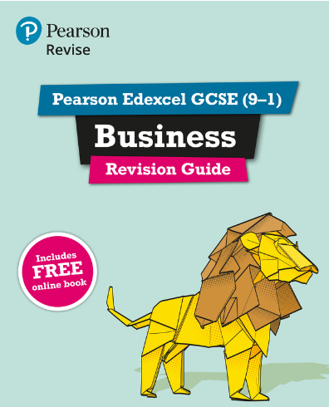
BBC Bitesize is a fantastic resource which also covers exam techniques.
Your teacher will have assigned you topics on Seneca learning to revise
Notes:
The Pearson revision guide is the book I would recommend for Business. It is available to buy on Amazon (the image on the slide is linked to Amazon). It also gives you access to an app you can install on your phone so you are able to revise if you don’t have the physical copy of the book with you. This book covers all the content for Theme 1 and Theme 2.
BBC Bitesize is a really useful resource for GCSE business, both to cover course content and to provide information and examples of exam techniques. The slide is linked to the exam technique section. Seneca Learning is another useful resource and your teacher will have set your assignments on Seneca but you are welcome to review any course content on this platform.

Slide 4
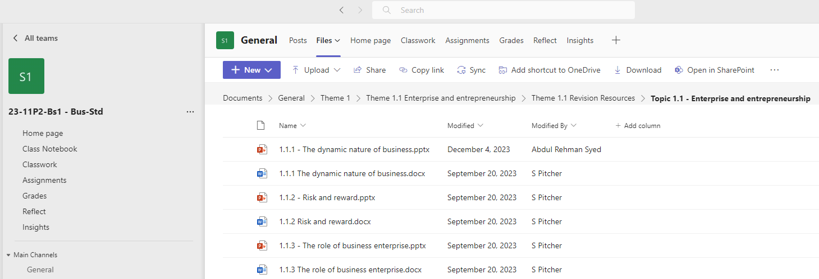
In the Files section on Teams, you will also find revision resources for every topic.
Notes:
Teams will be the most useful resource in the build up to exams. Here I will share all past papers with the examiner’s reports and mark schemes. There are already revision resources for every topic in the Files section, along with all PowerPoints and worksheets from lessons, so if you ever miss a lesson you are able to catch up. I would suggest you review all content at the end of each week using these Teams resources.

Slide 5
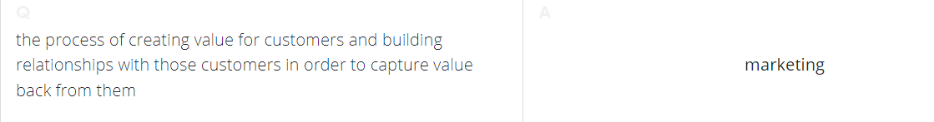
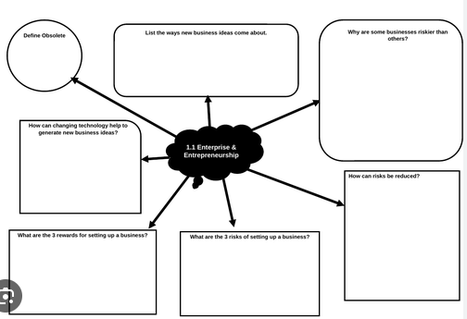
Other revision resources
Flash cards
Mind maps
Closed book note
making
Past papers
Notes:
Flash cards are particularly useful in a subject where there are so many key terms to learn. If you create flashcards with key terms on one side, and definitions on the other, this will allow friends and family to get involved in testing your knowledge.
Mind maps are another useful revision aid. We will have a mind map in your book for every topic, but making these independently without the use of revision guides would also be a good idea.
Do not spend ages copying out notes from textbooks or revision guides, but write down all you can remember about a topic and then use the revision guide or textbook to check how much you have remembered correctly.
You will have had the opportunity to see every past paper question before you sit your first exam in May; practising these questions is the best form of revision.
If you need any further help or advise then please ask. Thanks for watching.

