Slide 1



How to revise for your History GCSE
Exam Board | Paper | Topics | Length | %
AQA | 1 | Conflict and Tension: 1894-1918 Democracy and Dictatorship: 1890-1945 | 2 hours | 50
AQA | 2 | Norman England: 1066 - 1100 Britain: Power and the People: 1170-present day | 2 hours | 50

Slide 2
How to revise for your History GCSE
Revision is vital for all students – it is something we must do if we want the grades we deserve
You need to make sure you are being organised – a revision timetable is a great start
Your class teacher has put past papers, revision techniques and all lessons on their TEAMS – use these!
Limit distractions – make sure your phone is away whilst you are revising!
Make sure you have breaks and get lots of sleep ☺

Slide 3

Attend the revision sessions your teachers are running for you.
In the next coming weeks, your history teachers will be putting together a timetable of extra revision sessions they will be running – these could be before school or at lunchtime. Make sure you are attending these sessions – they are there to help you!
Please see your class teacher for more information regarding these sessions.

Slide 4
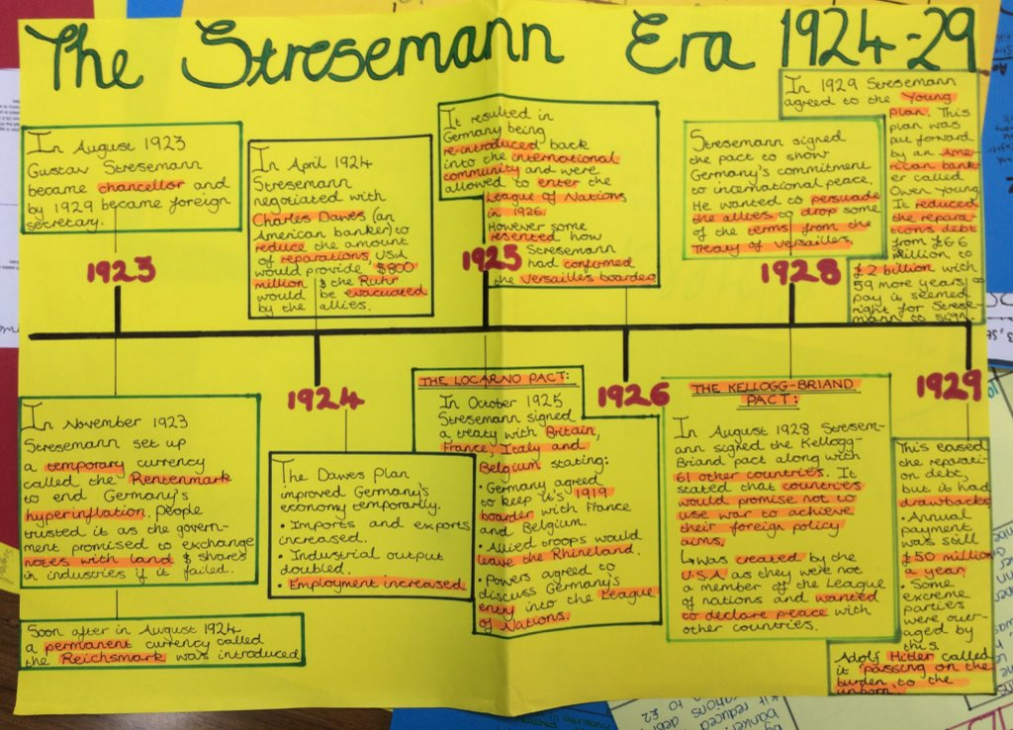
“The Big Picture in History”
You need to ensure you understand the big picture. You can do this by creating a timeline in chronological order of the period of history we have studied. E.g. The Weimar Republic

Slide 5
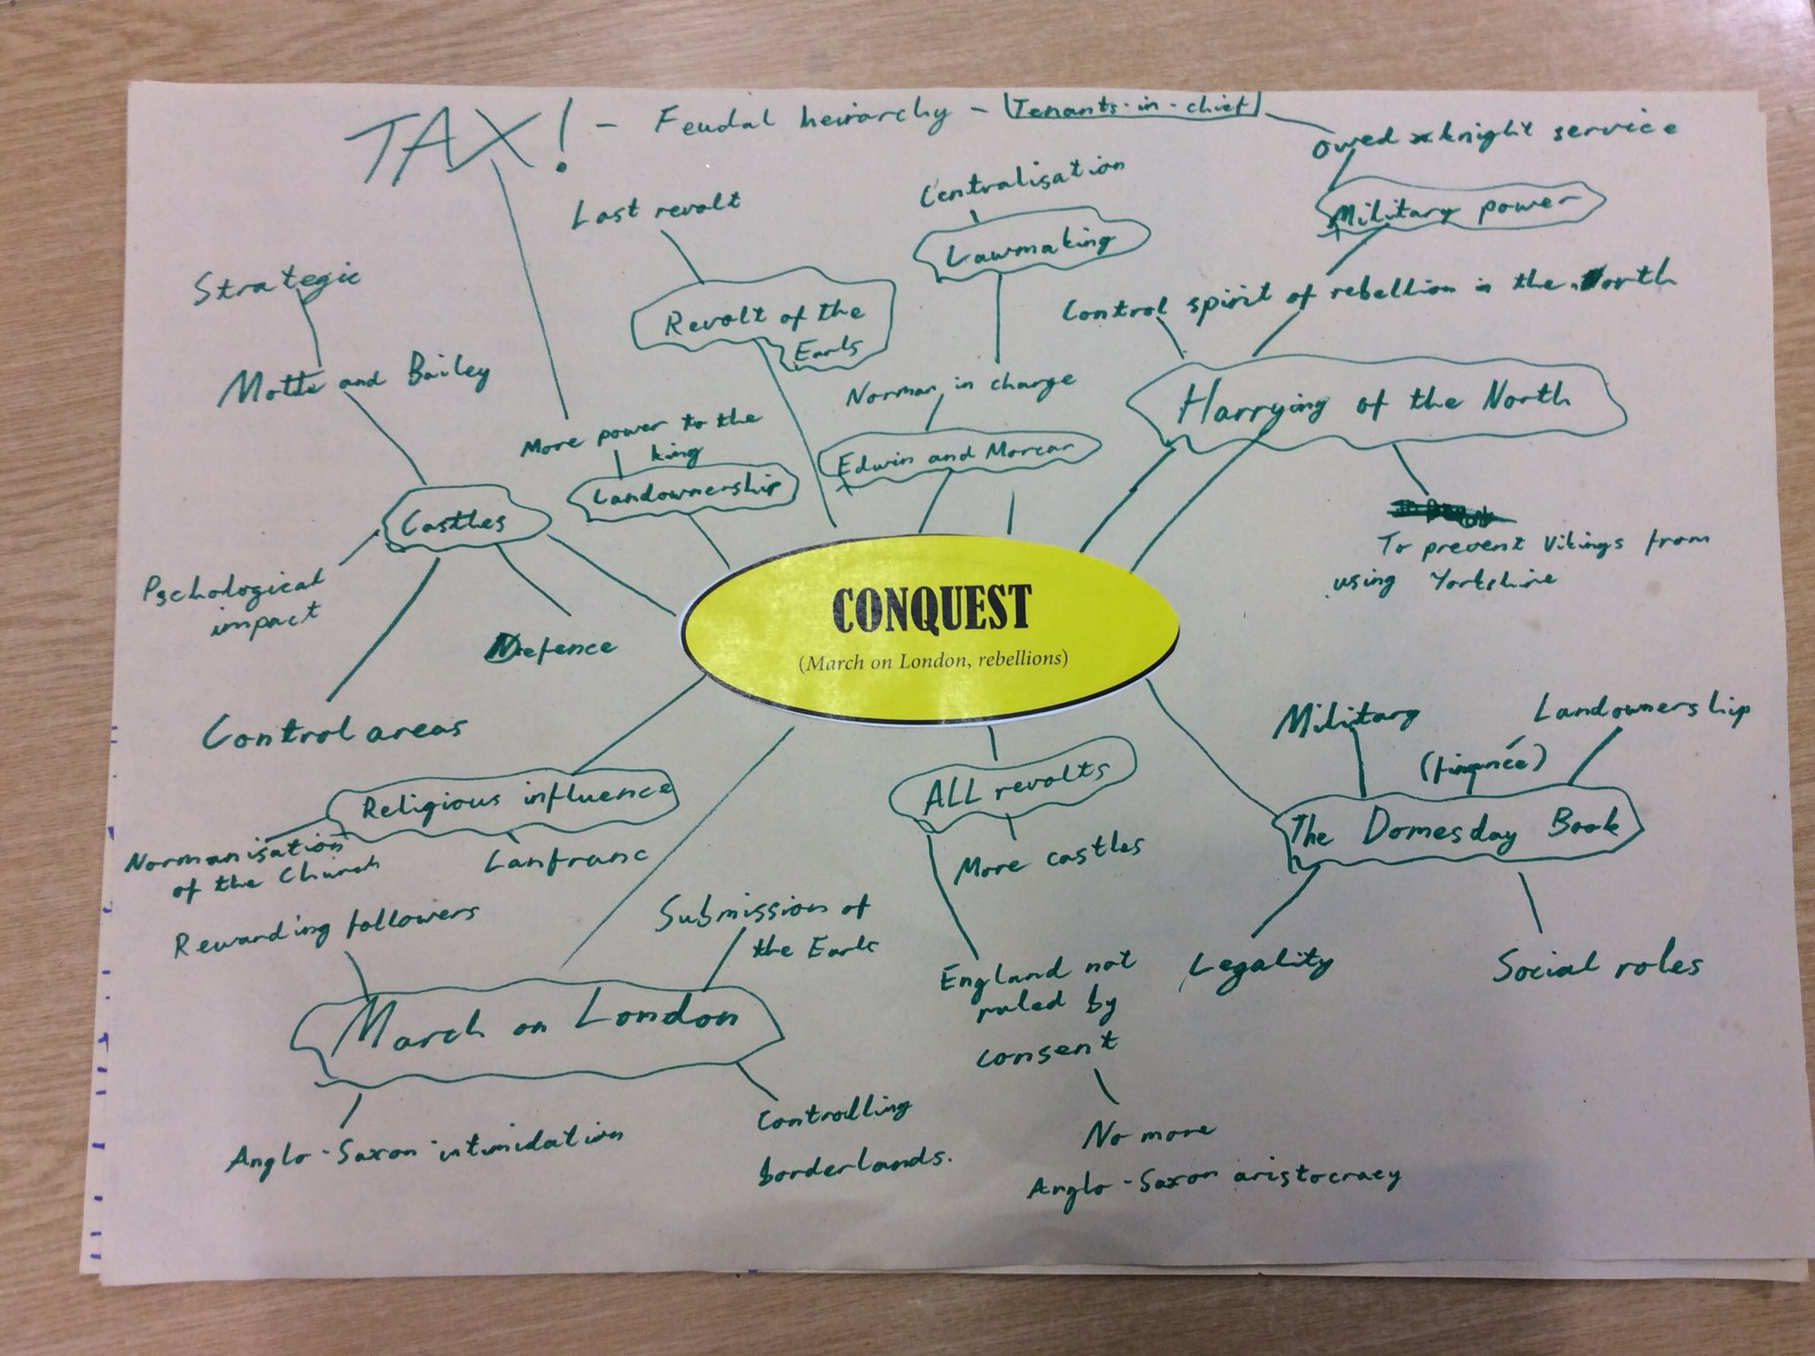
Using detailed mind maps
Mind maps are a great way of summarising knowledge and helps you make key links between the different events we study.
You need to show the examiner that you can remember a wide range of information about the time period.
Mind maps work best when they are colour coded. They can also work for broad topics and also specific events too. For example, you could make a mind map about – the whole of how William controlled England or just one way e.g. The Domesday Book

Slide 6
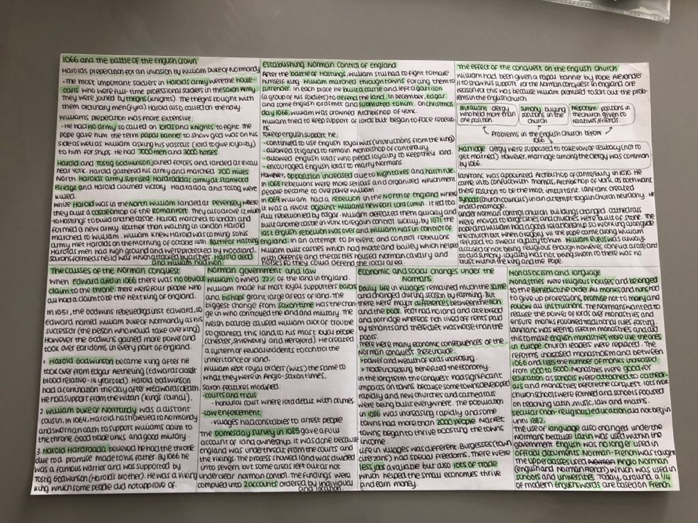
Fact files
If a mind map doesn’t work for you, a good way to organise the periods we have studied is through creating a fact file. This example has been highlighted – it is a good idea to associate particular colours with specific time periods or topics.
With fact files, like mind maps you can create them as broad or as narrow as you want

Slide 7
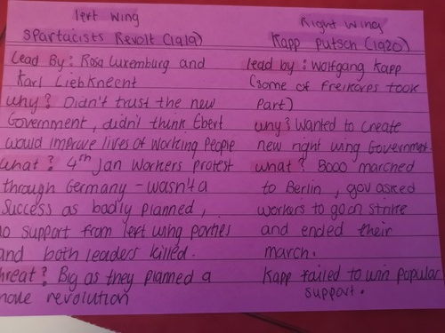
Make your own flashcards
Flashcards break down information into memorable chunks
Useful flashcards will have a question on the front, with an answer on the back
You can test yourself/each other with the flashcards you have made.
Flashcards will also help you understand where you have gaps in your learning – which is why it is vital you make your own and not rely on other peoples!

Slide 8


GCSE Pod
You all have access to a free GCSE Pod account, where you will find: Norman England, Democracy and Dictatorship and Conflict and Tension ‘pods’ to help your revision. Please ask your teachers if you need any support with accessing your GCSE Pod account.
For Power and the People, there is a helpful YouTube account by the University of Holloway which includes most of the topics you will cover in this module.
https://www.youtube.com/@HistoryHub/playlists

Slide 9
Past History Papers
Past papers will help you improve your subject knowledge, timing and writing structure.
Although we will continue to practice questions in our PPEs and during lesson time, it is important that you practice as many questions as you can before your exams.
Your class teacher will be happy to mark any past papers that you complete in your own time.
You can find past papers on your History class TEAMs channel, and also on the AQA website. Make sure you select the correct courses – which are on the first slide of this PowerPoint.

Slide 10
Retrieval Practice makes perfect!
Overall, you need to test yourself and strengthen your memory so on the day of your exam you are confident in what you know.
Test yourself on old topics
Mix up the order
Create quizzes
Interleave your learning – do not cram!

