Slide 1

GCSE Statistics
GCSE Exam Dates:
1F/1H Wednesday 05 June Afternoon 1h30m
2F/2H Monday 17 June Afternoon 1h30m
Exam Board: Pearson Edexcel
80 marks per paper (50% of marks each)
Both papers allow Calculators
Higher paper provides some of the formulae needed
Foundation paper does not provide any formulae normally

Slide 2
Top Tips! Exam Do’s and Don’ts
Do
Look after yourself Get a good night's sleep on the run up to your exams, but especially the night before your exam.
Eating a sensible diet, exercising and staying hydrated can all help with tackling your exams, so make sure you take good care of yourself on the run up to, and during your exams.
Stop and reset If your mind goes blank during an exam, it's perfectly fine to take a moment to regain your composure and get yourself back on track. If you do go completely blank in an exam, then try not to dwell on it, fold the corner of your exam paper at the point where you got stuck, then if you have time at the end, come back to that question.
Keep an eye on the time There should be a large clock in the exam room – make sure you can see it from where you're sitting. At the start of your paper, you can plan how long you want to spend on each question. Our top tip is to divide the time you have for your exam by the amount of marks in your paper, so sixty marks in one hour is one minute per mark – but make sure to allow enough time to make your plan, read the paper and to check your answers at the end.
Don't
Focus on other people Everyone works in different ways and at a different pace. Some people plan while others start writing straight away.
– just focus on your paper and putting your best effort into it. This is the only thing you can affect.
Close your paper when you've finished Once you're happy that you've answered as much of your exam as you can, if you've got time, go back through all of your answers before the exam finishes.
You might just think of an answer that you forgot earlier, or maybe you'll notice a spelling mistake.
Dwell on your last exam You can't change what's happened in the past, so once you leave the exam hall, try not to think about what you could have done differently. Instead, put all your energy into focusing on your next exam. If you do think that you made a mistake on your last paper then learn from it, and make sure you don't make the same mistake on your next exam!’ts

Slide 3
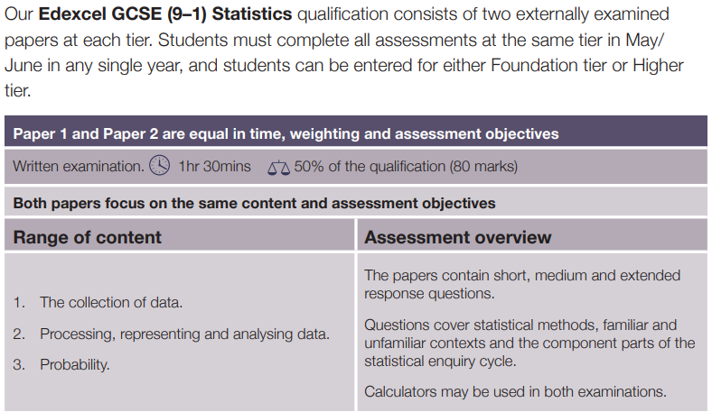
Statistics GCSE Overview

Slide 4
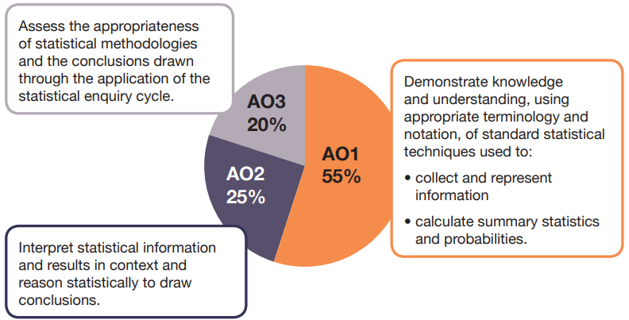
Types of Questions on the GCSE Papers

Slide 5
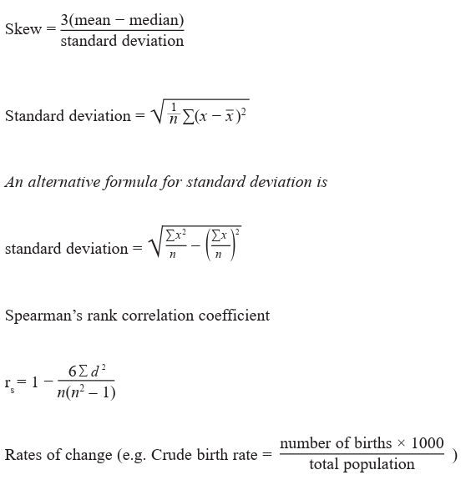
Higher Formulae (provided on paper)
List of formulae not provided are available on Teams

Slide 6
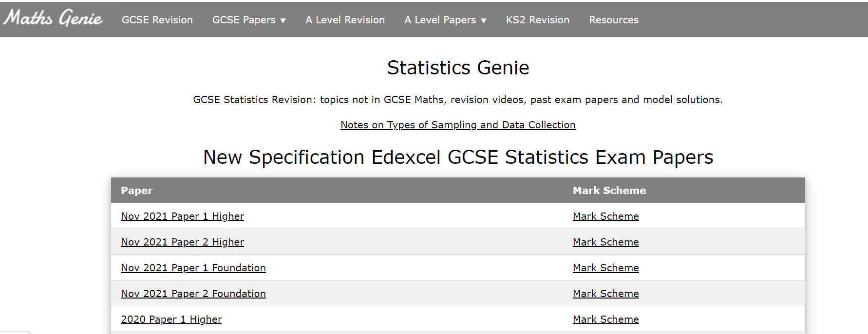
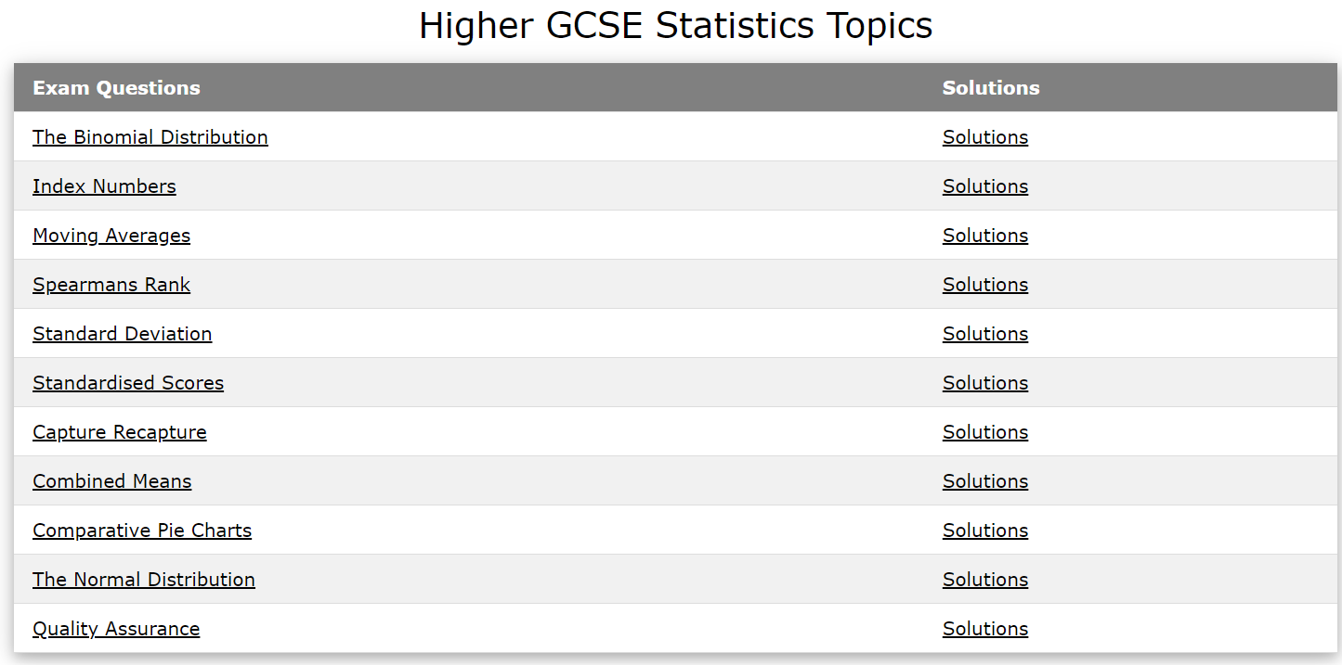
Statistics Revision Websites: Mathsgenie Statistics
Topic GCSE Questions
Past Papers

Slide 7
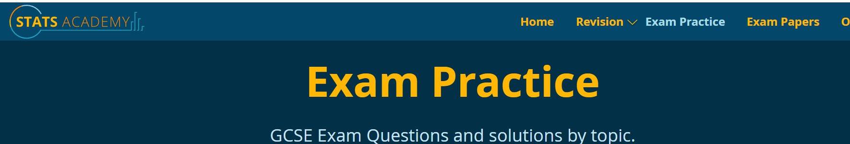
Statistics Revision Websites: Statsacademy
Includes:
Revision notes
Chapter notes
Past papers
GCSE topic questions

Slide 8
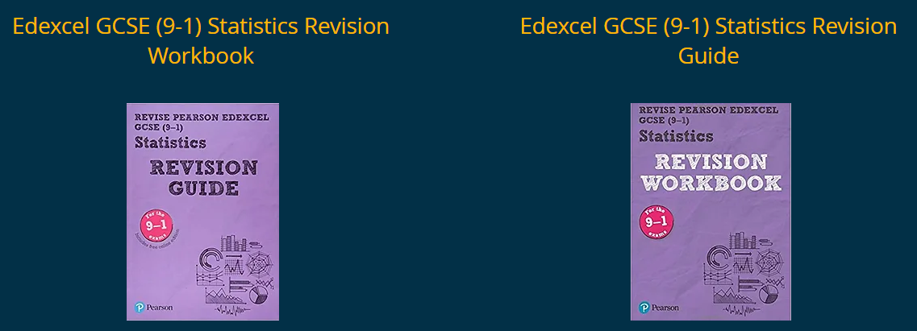
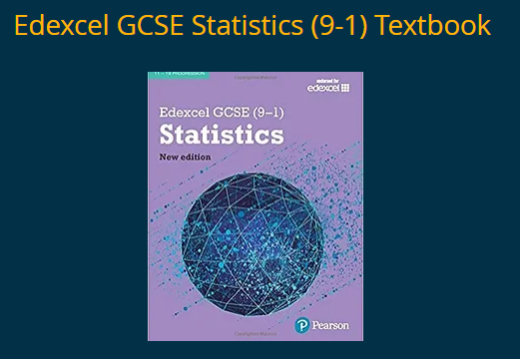
Statistics GCSE Revision Guides and Workbooks
Available on Teams as a PDF
You should have a copy of each of these already
Statistics GCSE Textbook PDF

Slide 9

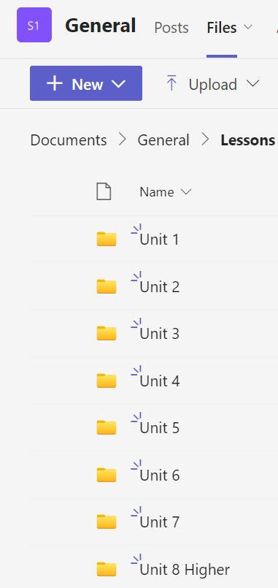
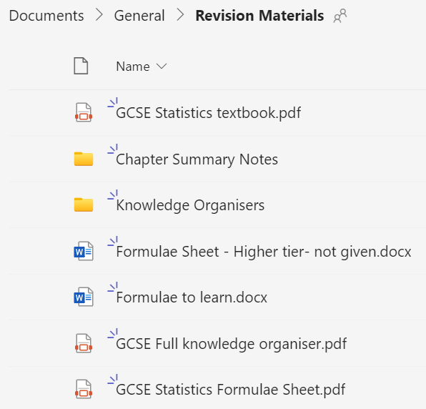
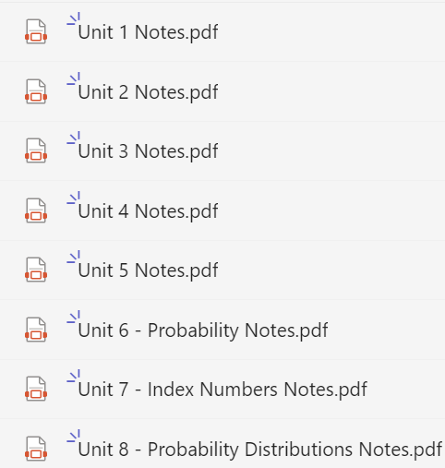
Teams: Includes all lessons, PDF Textbook, Unit notes etc
All lessons – General - files

