Slide 1
Unit 3 overview:
3.1 Understanding the effects of engineering achievements
3.2 Understanding properties of engineering materials
3.3 Understanding methods of preparation, forming, joining and finishing of engineering materials
3.4 Solving engineering problems

Slide 2

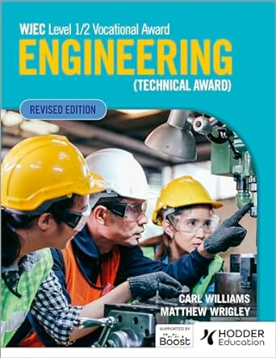
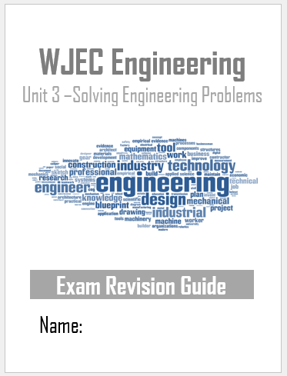
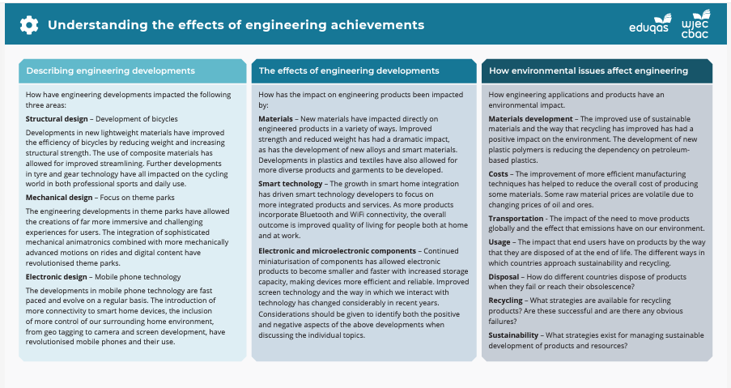
Resources:

Slide 3
This unit introduces learners to how engineering design is impacted by a range of external considerations such as the properties of materials, both traditional and smart developing materials, as well as methods of manufacturing in both the traditional and new and emerging technologies. The unit also gives the learner the opportunity to explore how engineering achievements have had an impact on modern day life at home, work and in society in general. Finally, the unit allows learners to develop understanding and skills to assist them in the solving of engineering problems.
This unit is externally assessed through a written examination available in January and May/June each year.
Duration: 1 hour 30 minutes
Number of marks: 80
Format: short and extended answer questions based around applied situations. Learners will be required to use stimulus material to respond to questions. This unit’s assessment will require learners to draw on knowledge and understanding from Units 1 and 2.
This assessment contributes 40% to the overall qualification grade.

Slide 4

Revision techniques:
When revising you can use techniques such as:
  Retrieval tasks
  Producing mind maps
  Flash cards
  Past papers
  Reading through your books
  Completing Seneca tasks

